Slide 1



Data Converter Design Techniques
  Brought to you by

Slide 2
Arrow Data Converter Design Techniques
You will learn how to
  Simplify the decision-making and design process for your next data converter design
  Evaluate the integrated data converters and other analog elements in the ARM-based Kinetis MCU family
  Use the Linear Technology (LTC) data converter playground board for the Freescale Tower System, to interface and test external precision data converters
Notes:
The main point is: what you will learn in this seminar. You will learn ADC parameters and system requirements so that you can decide whether to use embedded or external ADCs.

Slide 3
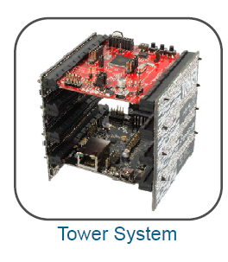
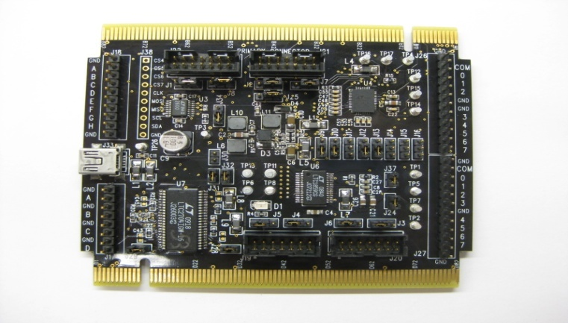
Data Converter Designs Made Simple
Arrow introduces the Linear Technology Analog Playground Board into the Freescale Tower Ecosystem
  Flexibility, ease of use, quicker evals, design verification, early issue resolution, rapid prototyping
  LTC Analog Playground board allows communication with the LTC A/D and D/A product portfolio using the flexibility of the Freescale Tower Platform
  Part #: TWR-ADCDAC-LTC
Analog playground board
Notes:
The main point is: The partnership with Arrow, LTC and Freescale.
Why LTC?
Premier high performance analog semiconductor manufacturer
Knowledgeable applications support
Long product life cycles
Short product lead times
Superior quality and performance
Premier analog global supplier at Arrow
Why Freescale:
Global leader in the design and manufacture of embedded semiconductors
Dominant share of industrial, communications, networking, and automotive markets
Superior design tools and technology alliances
Open source hardware and software to speed development
Premier embedded global supplier at Arrow

Slide 4
Agenda
Introduction to data converters
  Design considerations, embedded vs. external
Analog solutions from Linear Technology and Freescale Semiconductor
  Embedded solutions
  External solutions
Data converter evaluation techniques
Demos using tower platform and analog playground board
Notes:
Discuss the Agenda.

Slide 5
Signal Chain for Data Acquisition Systems
5
Notes:
9/22/2011
5
Describe the signal chain here.
The basic building block of the signal chain is the sensors, mux, operational amplifier, ADC, Filters etc.

Slide 6
What Does An Analog to Digital Converter (ADC) Do?
ADC mixed-signal device
  Analog input
  Digital output
For a 3-bit ADC, there are 8 (2³) possible output
  In this example
    Input voltage is 5.5V
    Reference voltage is 8V
    Output will be 101
More bits give better resolution and smaller steps
Vref
Vcc
Vref
Vcc
Digital
Digital
Output
Output
0V < 000 < 1V
1V < 001 < 2V
Analog
Analog
2V < 010 < 3V
Input
Input
3V < 011 < 4V
4V < 100 < 5V
5V < 101 < 6V
6V < 110 < 7V
GND
7V < 111 < 8V
GND
Notes:
Here is an example of a 3-bit A/D converter. Because it has 3 bits, there are 23 = 8 possible
output codes. The difference between each output code is VREF / 23.
Assuming that the output response has no errors, every time you increase the voltage at the
input by 1 Volt, the output code will increase by one bit. This means, in this example, that the
least significant bit (LSB) represents 1 Volt, which is the smallest increment that this converter
can resolve. For this reason, we can say that the ρεσολυτιον of this converter is 1.0V because
we can ρεσολϖε voltages as small as a volt. Ρεσολυτιον may also be stated in βιτσ.
Note that if you reduce the reference voltage to 0.8V, the LSB would then represent 100mV,
allowing you to measure a smaller range of voltages (0 to 0.8V) with greater accuracy. This is
a common way for our customers to get better precision from a converter without buying a
more expensive, higher resolution converter.
The Resolution of an A/D converter is the number of output bits it has (3 bits, in this example).
Resolution may also be defined as the size of the LSB (Least Significant Bit) or one count (1
Volt, in this example).

Slide 7
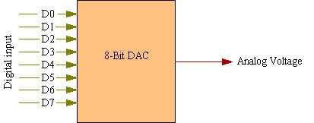
What Does A Digital to Analog Converter (DAC) Do?
DAC mixed-signal device
  Digital input
  Analog output
A DAC is a device that
Converts a digital code to an analog signal (current, voltage)
Vcc
Vref
GND
Notes:
A DAC converts an abstract finite-precision number (usually a fixed-point binary number) into a physical quantity (e.g., a voltage or a pressure). In particular, DACs are often used to convert finite-precision time series data to a continually varying physical signal.
The most common types of electronic DACs:
The pulse-width modulator, the simplest DAC type. A stable current or voltage is switched into a low-pass analog filter with a duration determined by the digital input code. This technique is often used for electric motor speed control, but has many other applications as well.

Slide 8
ADCs Measure Signals From DC to MHz
Delta Sigma ADCs
  Ideal for precision, high-resolution DC measurements
Successive Approximation Register (SAR) ADCs
  Ideal for measuring DC signals to input frequencies at a few megahertz
High-Speed ADCs
  Ideal for fast AC applications
Notes:
ADC Mixed-Signal Device
– Analog Input
– Digital Output
• May be Considered to be a Divider
– Output says: Input is What Fraction of VREF?
– Output = 2n x G x AIN / VREF
• n = # of Output Bits (Resolution)
• G = Gain Factor (usually “1”)
• AIN = Analog Input Voltage (or Current)
• VREF (IREF)= Reference Voltage (or Current)
Because the Analog-to-Digital Converter (A/D Converter or ADC) has both analog and digital
functions, it is a mixed-signal device. Many of us consider the ADC to be a mysterious device.
It can, however, be considered very simply to be the instrument that it is: a device that
provides an output that digitally represents the input voltage or current level.
Notice I said voltage or current. Most ADCs convert an input voltage to a digital word, but the
true definition of an ADC does include the possibility of an input current.
An ADC has an analog reference voltage or current against which the analog input is
compared. The digital output word tells us what fraction of the reference voltage or current is
the input voltage or current. So, basically, the ADC is a divider.
The Input/Output transfer function is given by the formula indicated here. If you have seen this
formula before, you probably did not see the “G” term (gain factor). This is because we
generally consider this to be unity. However, National Semiconductor has introduced ADCs
with other gain factors, so it is important to understand that this factor is present.

Slide 9
Delta Sigma ADC Applications
Notes:
9
9
The most measured parameter in the world is temperature. Most temperature measurements do not require high resolution. However, in handheld meters and industrial process control applications, there is a need for greater than 16-bit resolution of thermocouple outputs. Certain chemical processing applications need to resolve fractions of a degree while the range may be a thousand degrees. Depending on the application, this may require a differential input ADC or in other cases a single-ended ADC is acceptable.
Flow meters generally contain multiple measurements of low-level sensors. Our multi-channel ADCs are perfect in these applications. Typically, it will be the higher speed series, LTC2440. But other times, the low power of the LTC2410 series is critical.
Pressure transducers and any type of bridge measurement needs both a differential input for the bridge as well as a differential reference input to deal with offsets. For most applications, our ADC can be directly driven by the bridge.
Voltage and current monitoring is found in nearly every application. Digital voltmeters (DVMs) and digital multimeters (DMMs) are but one application. Our 16-bit devices have great performance and a low price, making them acceptable in network switching equipment and servers to monitor power. We’ve even worked with Power over Ethernet (PoE) customers – floating the LTC2433-1 from the –48V supply to monitor load current.

Slide 10
SAR ADC Applications
Notes:
Example applications.

Slide 11
High-Speed ADC Applications
Notes:
Example applications.

Slide 12
The Question: When to use External ADC vs. Embedded ADC?
It depends …

Slide 13
Decision Tree
External or Embedded Data Converters
System
Requirements
Do requirements exceed capability
of embedded ADC or DAC?
No
Consider secondary factors
Yes
Use external ADC or DAC
Notes:
The decision to use external and internal data converter is not very straight forward, black and white type of decision. The topic of this training is the technique -
We are going to talk about some techniques/ guide lines which will help the system designer to make the ADC decision relatively easier. The first requirement is to understand the
System requirements.

Slide 14
Choice of ADC Depends On System Requirements
What Resolution (number of bits) is required?
How much bandwidth the system needs (Sampling Rate) and what is the Input Frequency Range?
Dynamic range (signal-to-noise ratio or SNR and spurious free dynamic range or SFDR) required
Is Power Consumption important?
Is small size important?
How will you Drive the ADC?
Cost
Notes:
The value of an LSB depends upon the
ADC Reference Voltage and Resolution
VREF Resolution 1 LSB
1.00V 8 3.9062 mV
1.00V 12 244.14 μV
2.00V 8 7.8125 mV
2.00V 10 1.9531 mV
2.00V 12 488.28 μV
2.048V 10 2.0000 mV
2.048V 12 500.00 μV
4.00V 8 15.625 mV
4.00V 10 3.9062 mV
4.00V 12 976.56 μV

Slide 15
What Resolution Do I Need?
System Requirements (DC):
  Minimum input signal (V_{MIN})
    Translates to ADC offset spec
  Minimum detectable change (ΔV)
    Translates to ADC resolution and DNL spec
  Maximum input signal (V_{MAX})
    ΔV / V_{MAX} defines required number of counts
    ADC resolution must exceed number of counts
    V_{MAX} may dictate reference voltage
  Programmable gain or attenuation will affect these parameters
Notes:
To understand the system requirement the system designer needs to understand couple of parameters like: what is the minimum input signal voltage, what is the minimum
Detectable change the system needs to recognize, what is the maximum voltage of the input signal, what is power requirement, what is the sampling rate etc. Based on what is the most important parameter for the System, the designer can look into the related important parameter of the ADC/DAC.

Slide 16
What Sample Rate Do I Need?
f_{SAMPLE} ≥ 2 × f_{SIGNAL} (Nyquist)
Might be a lot higher!
  If post-processing is required
What about “DC” signals?
  ΔΣ ADCs internally oversample to eliminate 50Hz/60Hz line noise
What about “single shot” measurements?
  SAR ADCs are best for this
  Check if minimum sample rate is specified
Notes:
In signal processing, the Nyquist rate, named after Harry Nyquist, is two times the bandwidth of a bandlimited signal or a bandlimited channel.
The problem that can arise is that the sampling rate determines how well you can reconstitute the signal - to plot a graph, or to acccurately copy a voice signal. We need to think about a few ideas first.
The signal we are sampling has a frequency spectrum. Let us assume that the highest frequency component in the signal is f_{max}.
If you are familiar with Fourier Transforms, you may realize that frequency spectra of realistic signals are not zero above some arbitray frequency. A real signal will have a spectrum that gets smaller and smaller at higher and higher frequencies, but which only approach zero asymptotically. We are really assuming that our signal has negligible components above f_{max}.
To reproduce a signal with a highest frequency component, f_{max}, the sampling frequency (the frequency at which samples are taken) must be at least twice the highest frequency component. In other words, the signal cannot be reproduced accurately unless the sampling frequency is at least 2f_{max} - a frequency that is referred to as the Nyquist frequency for the signal. If the sampling frequency is lower than the Nyquist frequency, that is referred to as undersampling.
The utility frequency, (power) line frequency (American English) or mains frequency (British English) is the frequency at which alternating current (ac, also AC) is transmitted from a power plant to the end-user. In most parts of the world this is 50 Hz, although in the Americas it is typically 60 Hz. Current usage by country or region is given in the list of mains power around the world.
16

Slide 17
Input Resolution Overview
Notes:
Quantization noise is a noise error introduced by quantization in the analogue to digital conversion process. It is a rounding error between the analog input voltage to the ADC and the output digitized value. The noise is non-linear and signal-dependent. Electrical noise is the noise inherent in the sampling process, with an RMS value of SQRT(kT/c), where SQRT is the square root function, k is Boltzmann’s constant (1.38x10^-23 joule/kelvin), and C is the size of the sample capacitor.
One of these noise sources will dominate, as shown in the figure. If the size of 1 LSB is much greater than the RMS electrical noise, then it is the limiting factor (“Quantization limited”.) If the electrical noise is much greater than 1 LSB, then it is “Electrical noise limited.”
If quantization noise is limiting, you can reduce the reference voltage to achieve an increase in resolution, which is a simpler alternative to adding a gain stage.
If electrical noise is limiting, reducing the reference voltage will NOT increase resolution; reducing the reference by a factor of 2 will simply make the noise in the output codes increase by a factor of 2. (When converted to voltage, the RMS noise will be the same.)

Slide 18
Increase the Number of “Counts” with Programmable Gain Amplifier (PGA)
5V Ref
PGA
5V
12
= 1 LSB = 1.22mV
-
Gain =
Bit ADC
4096
500x
Low Level Sensor
PGA Full
-
scale
Full
-
scale = 10mV
Output = 5V
Total counts from the sensor without PGA
Total counts from the sensor with PGA
10mV
5V
= 8 counts
= 4096 counts
1.22mV
1.22mV
Notes:
If you need more resolution then you can add PGA in front of the ADC. The example shows the ADC counts incresae from 8 to 4096 by using the 500x PGA.
Some ADC has built in PGA.

Slide 19
Errors Specifications
Integral Non-Linearity: INL
Differential Non-Linearity: DNL
Signal to Noise Ratio: SNR
Signal to Noise and Distortion Ratio: SINAD
Effective Number of Bits: ENOB
Spurious-Free Dynamic Range: SFDR
Notes:
Sources of noise:
Inadequate supply bypassing
Noisy components/conditioning circuitry
Quantization
Clock
Output to input coupling

Slide 20
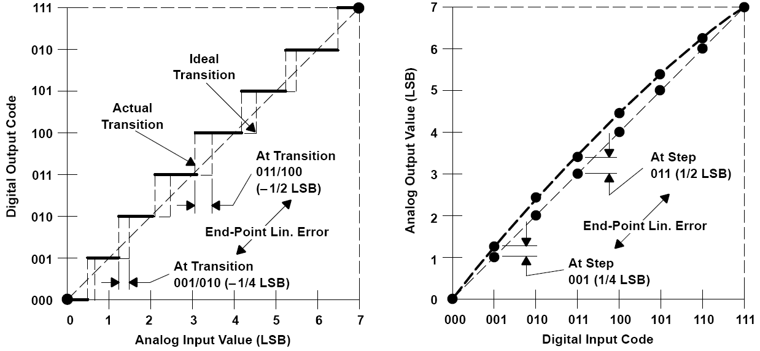
INL: Integral Nonlinearity for ADCs & DACs
ADCs
Notes:
INL measures the deviation from the ideal transfer function of an ADC or DAC
In more fundamental terms, INL represents
the curvature in the Actual Transfer Function
relative to a baseline transfer function, or the
difference between the current and the ideal transition voltages. There are
three primary definitions of INL in common use. They all have the same
fundamental definition except they are measured against different transfer
functions. This fundamental definition is:
Code INL = V(Current Transition) – V(Baseline Transition)
INL = Max(Code INL)

Slide 21
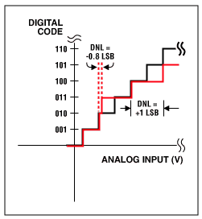
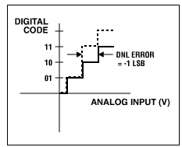
DNL: Differential Nonlinearity for ADCs
Missing Code!
Notes:
The key for good performance for an ADC is the claim "no missing codes." This means that, as the input voltage is swept over its range, all output code combinations will appear at the converter output. A DNL error of <±1LSB guarantees no missing codes (Figure 1a). In Figures 1b, 1c, and 1d, three DNL error values are shown. With a DNL error of -0.5LSB (Figure 1b), the device is guaranteed to have no missing codes. With a value equal to -1LSB , the device is not necessarily guaranteed to have no missing codes. Note that code 10 is missing. However, most ADCs that specify a maximum DNL error of +/-1 will specifically state whether the device has missing codes or not. Because the production-test limits are actually tighter than the data-sheet limits, no missing codes is usually guaranteed. With a DNL value greater than -1, the device has missing codes

Slide 22
When DNL and INL Matter
Closed-Loop or feedback systems
  DNL (no missing codes) required for the system to converge
  Offset and gain errors can be calibrated out
  INL may not matter
Open-Loop or absolute measurements
  INL directly affects measurement accuracy
  Offset and gain errors are significant
  DNL less important (but usually necessary to achieve good INL)
Notes:
In a closed loop system - When one or more output variables of a system need to follow a certain reference over time, a controller manipulates the inputs to a system to obtain the desired effect on the output of the system.
A characteristic of the open-loop controller is that it does not use feedback to determine if its output has achieved the desired goal of the input. This means that the system does not observe the output of the processes that it is controlling. Consequently, a true open-loop system can not engage in machine learning and also cannot correct any errors that it could make. It also may not compensate for disturbances in the system.

Slide 23
Key AC Specifications
Specification | Formula
Signal to Noise Ratio (SNR)
Theoretical SNR
Signal to Noise Plus Distortion Ratio (SINAD)
Effective Number of Bits (ENOB)
Notes:
SNR: Signal-to-Noise Ratio, the ratio of the RMS amplitude of the desired signal at the ADC output to the RMS amplitude of all the other spectral components except the first 5 harmonics and DC.
SINAD(S/N+D): Signal to Noise Plus Distortion Ratio, the ratio of the RMS amplitude of the desired signal to the RMS amplitude of all the other spectral components at the ADC output. Band-limited to frequencies above DC up to the Nyquist frequency.

Slide 24
Spurious-Free Dynamic Range (SFDR)
SFDR: Ratio of the RMS amplitude of the carrier frequency to the RMS value of the next largest noise or harmonic distortion component.
SFDR is an important specification in communications systems because it represents the smallest value of a signal that can be distinguished from a large interfering signal (blocker)
Notes:
Spurious Free Dynamic Range (SFDR) is the difference between the value of the desired
output signal and the value of the highest amplitude output frequency that is not present in the
input, expressed in dB. Some ADC suppliers ignore harmonics when specifying SFDR, but this
practice is valid only if those harmonics were present at the ADC input.
Because SFDR is expressed in dB below the fundamental, it is sometimes expressed in
negative dB. However, since it is a ρανγε, it should be expressed in positive dB.

Slide 25
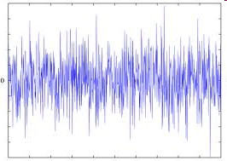
Some Sources of Noise & Distortion
Inadequate supply bypassing
Noisy components/conditioning circuitry
Quantization
Clock
Output to input coupling
Board Layout
Notes:
There are many sources of signal degradation in any analog signal chain and the circuitry
associated with an ADC has its share. Many of the problem areas mentioned here are
common to any analog circuitry.

Slide 26
What are the Different Signal Types?
Notes:
26
For voltage input ADCs, three different input structure types exist: Single-Ended, Pseudo-Differential and Fully-Differential. The simplest solution is to select an ADC input structure that matches the sensor output. However, there are trade-offs with each structure that should be considered. In addition, if signal-conditioning circuitry is used between the sensor and the ADC, this circuitry can affect the ADC input structure choice.
Fully-Differential Inputs: Differential usually means constant common mode. Figure 2a and 2b shows an example of a fully-differential ADC T/H input structure and its signal type. Advantages of fully differential input are common mode noise rejection (in some cases) and the input range is maximized, increasing dynamic range. Note that the LTC2261 has a 1.8V supply, but a differential input range of 2V peak to peak, as both inputs are driven.
Single- Ended usually means one input is at ground
Pseudo Diff. usually means (-) input is offset from ground
*Any of the above can be unipolar or bipolar
*Bipolar simply means the (-) input can be more positive than the (+) input
***None of these imply anything about the signal’s range, or its ability to go outside of an ADC’s supply rails! Read datasheets thoroughly.
System Requirements & Ground
Signal Source Ground vs. System Ground
High Precision Requires a Stable Ground
Floating or Ground-Referred Signal?
Rejection of Common-Mode Noise
Local Measurements (Common Ground)

Slide 27
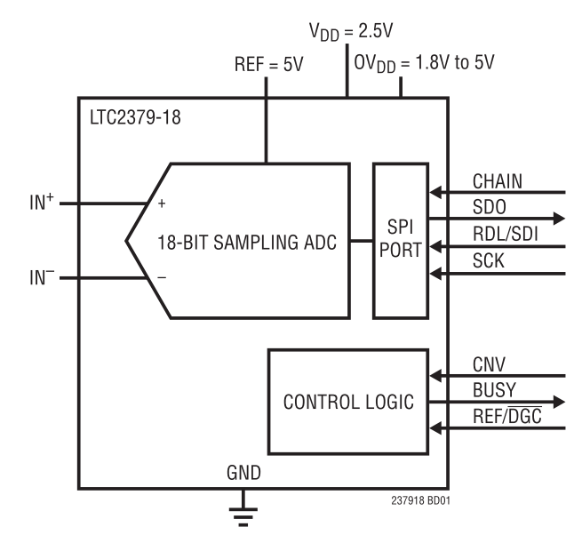
Generic Stand Alone ADC Blocks
Notes:
This is a typical block diagram of a stand alone ADC as illustrated by the LTC2379. Notice that the ADC gets to sit in the silicon substrate all by itself. As long as the layout around the ADC is well done, there is very little source of noise to couple to the ADC.

Slide 28
Use Case: Simultaneous Sampling ADC Monitors 6 Channels at the Same Instant
External ADCs are better at applications needing faster sampling rate or high resolution
Notes:
This is an example, Motor controller, where simultaneous sampling, precision in measurement and relatively higher sampling rate are needed. This is an application where the use of the external ADC is most likely.

Slide 29
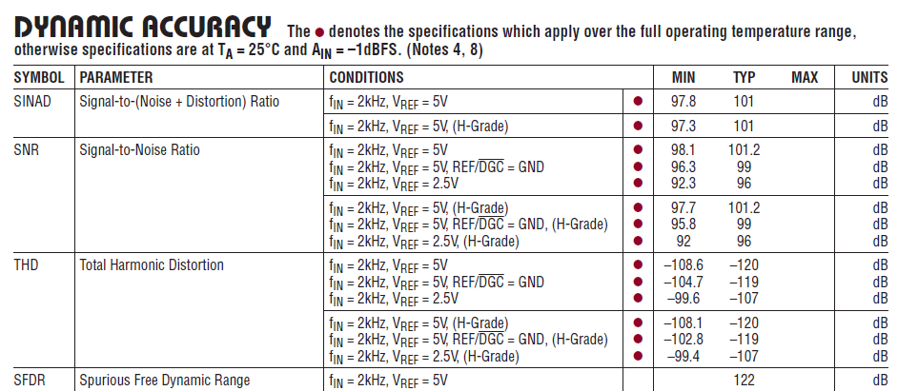
External ADC Datasheet Spec
An excerpt from a specification table for LTC2379 SAR ADC
Notes:
Pay attention to the red dot next to the specification min, max numbers. This dot tells you that these specs are guaranteed over the temperature range the part is specified for. You have to design the specs to cover all cases of the applicable temperature ranges.

Slide 30
Embedded vs. External Data Converters
Parameter | Embedded | External | Comments
Resolution | <=12b | => 16b | ENOB should be taken into account
Sampling rate | <= 1M | DC to 10M | External can go to GHz
DNL/INL | Typical | Guaranteed
SNR | Good, Typ. | Better, Tested | For 16 bit ENOB
Power | Usually less than external | Higher | There are exceptions, many extreme low power.
Component Counts | One chip solution (ADC+ Controller) | Two chip solution (ADC+controller) | Component count is usually higher for the external solution.
Drive | Usually Single-Ended | All three kinds | Single Ended, Differential, Pseudo Differential
Notes:
This is a table to give a very top level view of where the external and embedded ADCs fit. As mentioned earlier, the choice depends on the system requirements.
Resolution: External ADC can go in higher resolution compared to the embedded one. If anyone needs higher resolution >=16b, the external ADC can offer multiple options.
Sampling Rate: There are more choices for the sampling rate for the external ADC. It can go from DC to multiple GHz.
Power: This is very subjective and depends on a lot of things from design, process technology etc. It is better to refer to the datasheet to get the power spec. of the ADC.
Component Count: Here the assumption is, as the embedded ADC is inside the micro, you just need a single chip for the ADC and controller.
Drive: External ADC offer more options for the different type of drive signal.

Slide 31
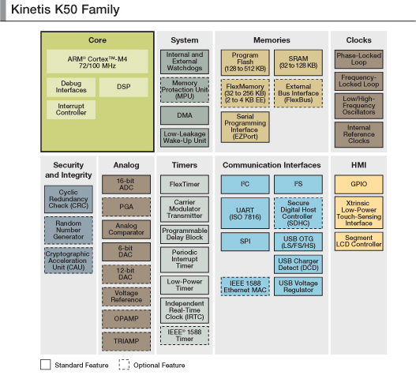
Generic Embedded Analog Block
Notes:
This is the block diagram of a typical microcontroller that contain analog block. You can see that the analog mixed signal resides in the same silicon substrate as all of the other noisy blocks of circuit. The fast switching core, memory modules and IOs contribute noise to degrade the SNR of the mixed signal on the board. A lower SNR leads to a lower ENOB (effective number of bits).

Slide 32
Use Case: Blood Pressure Monitor
Embedded
Analog
VREF
PDB
VREF
PDB
SW
SW
SW
SW
500 Hz
Filter
500 Hz
Filter
Filter
Filter
Low
Low
Pressure
Pressure
Sensor
Pass
Sensor
ACMP
2 x ADC
Pass
ACMP
2 x ADC
Filter
ARM
Filter
ARM
ARM
ARM
Cortex M4
Cortex M4
Cortex M4
Cortex M4
Add an spirometer
CPU
CPU
CPU
CPU
with the 2
ADC
nd
LCD
Segment
TRIAMPS
LCD
Segment
TRIAMPS
LCD
Segment
CNTRL
Display
OPAMPS
CNTRL
Display
OPAMPS
CNTRL
Display
Touch
Touch
Ethernet
Touch
Ethernet
USB
TSI
Ethernet
USB
TSI
Pad
Pad
Pad
External
External
SPI
External
MCU
SPI
Bus
Bus
Bus
Pressure
Pressure
DC Brush
Sensor
DC Brush
Sensor
Motor
Motor
CNTRL
CNTRL
Analog
Analog
Sensors
Sensors
Peripherals
Peripherals
Graphic
Pump
Graphic
Pump
Graphic
Pump
Display
motor
Display
motor
Optional
Optional
Internal Modules
motor
Display
Internal Modules
Bleed
Bleed
Bleed
NVM
NVM
valve
NVM
valve
valve

Slide 33
Review of Embedded Analog Solutions

Slide 34



Kinetis K50 Microcontrollers
The Integration Benchmark for Measurement and Monitoring
NEW
Integrated
Measurements
Integrated measurement engine,
allowing reliable processing of analog signals
Integration
LCD
Ethernet, I2C, UART, I2S
Flash/SRAM
Touch Sensor
GPIO
Kinetis K50 Microcontrollers
based on the ARM
Cortex-M4 core
Connectivity
Options
Monitor,
evaluate and control
system variables
Design Ease
MQX
Tower
TWRLTC (Playground)
Codewarrior
To shorten design cycles
Notes:
Read the slide to the crowd ☺
34

Slide 35
What Is Embedded Analog?
Includes The Following Analog
ADCs
DACs
Op-Amps
Transimpedance Amps
Programmable Gain Amps (ADC)
Comparators
VREFs
Muxes
Analog - Plus Additional Features
Programmable Delay Blocks
Timers
Configuration Flexibility
Programmable
Digital Filtering
Programmable Hysteresis
Averaging
Synchronized Sampling
Low Power Modes
Integrated Processor
Integrated Connectivity Engine
PWM (FlexTimer)
Answer: Embedded Analog Is A System-On-A-Chip (SOC)
Notes:
Simply put the embedded analog techniques are all the features and peripherals on the right. Embedded analog is extremely
flexible in terms of configuration and programmability. Each additional peripheral enhances the analog components on the left.
Programmable Delay Blocks are delays and timers that can be used to initiate ADC and DAC conversions. This reduces
processor overhead and allows the processor to concentrate on other tasks. With a few simply instructions to configure
registers the programmable delay blocks can take over the tedious timing tasks and the processor can read results when they
are available. Timers can be used in conjunction with the PWM controller (FlexTimer). In fact you will see how the PWM controller is
used for one of our use cases (Pulseoximeter) later on in the presentation. To find an example of configuration flexibility one
only has to look at the ADC. The ADC can be configured from 8 to 16 bit resolution. Digital filtering is basically making sure the
signal is valid for a minimum amount of time. Is the input voltage greater than the reference voltage for 6 clocks. I know it’s
basic filtering but still comes in handy. Filtering is very helpful when utilizing the embedded comparators. Averaging is another
form of filtering. The ADC can average up to 32 conversions. This extends the Effective Number of Bits (ENOB) beyond 13 bits.
Four levels of programmable hysteresis are also available (comparators). Synchronized sampling doesn’t seem like a big deal but
this allows the userto synchronize to the system clock. It allows the embedded analog signals to enter into the digital domain.
The last three bullets you’ll find in almost any processor but this is really important for medical applications as almost all need to
report their results. Reporting results can vary from reporting data to a PC via TCP/IP or USB to simply updating an LCD display.
As you can see the combination of embedded analog and the techniques associated with it can be very powerful in terms of
cost, space and power savings. As you look at the upcoming slides don’t think of the features as marketing fluff but rather as
techniques that expand and enhance embedded analog.
35

Slide 36
Embedded Measurement Engine IP
VREF To External Components
External Voltage
Reference
External
Voltage Input
Data converters
  16b Analog-Digital SAR Converter
  12b Digital-Analog Converter
  Programmable Delay Block
Dynamic and Static Biasing
  1.2 V Trimmable Voltage Reference
  Analog Comparator with Prog. Reference
  Low temperature drift output, Current drivers, trimmed output
Signal Conditioning
  Trans-Impedance Amplifier
  General Purpose Operational Amplifier
  Low pass Filter
  Unity gain buffer
2-TRIAMP
(500pA bias current)
2-OPAMP
(2nA bias current)
(internal resistor ladder)
VREF
1.2V 40PPM/°C
ADC
16 bit
w/8 register and
result registers
Programmable
Delay Block
PDB
(16 bit Counter)
DAC
12 bit
w/ 16 word
FIFO buffer
(9 – 16 bit registers)
Notes:
So what is embedded measurement engine IP? A measurement engine is a group of analog and digital peripherals in a signal chain that can be used together to
condition an analog signal. Basically it prepares an analog signal so that a result can be processed by a microprocessor. You’ll notice the slide is very generic in terms of
identifying the supplier. That was done initially, later in the presentation as you know the K50 will be identified. When the K50 added TriAmps and Op-Amps to the Common
Analog IP, the measurement engine was born. The intent is to discuss techniques and not a bunch of marketing slides. Some or all of the peripherals can be found
in almost any embedded measurement engine. I do want to mention that a 16 bit ADC is quit impressive for an embedded solution. Not many suppliers offer an
embedded 16 bit ADC. So the K50 does stand out. Obviously there are many external solutions that have higher resolutions. If you chose too you can demo the ADC
spreadsheet during the presentation. The ENOB is much better than one would expect for an embedded solution. The ADC consists of a 16 bit successive
approximation ADC (SAR) which can easily achieve 13.5 ENOB accuracy. This accuracy could be expanded to a higher value when using modules like the hardware
average. I mentioned this in the previous slide again this is an embedded technique. There are up to 2 x 16-BIT ADCs. There is also up to 2 x 12-BIT DACs, this
can be used to trigger external peripherals as we will see later in the presentation. A great but not very well know peripheral is the PDB. The programmable
delay block is used to synchronize measurements from the ADC and DAC modules. Basically you tell the ADC when to sample and the DAC when to output
by programming determined triggers for each of the independent channels. This comes in handy during analog signal processing especially when one is
trying to build a waveform and minimize microprocessor overhead. We’ll see this later in the presentation. The VREF or voltage reference module supplies a 1.2V
Trimmable voltage reference to the analog peripherals to enhance their accuracy. It can also be used to supply a reference to external peripherals. This reduces
component count and the cost of implementing this reference externally. Integration another technique that has made embedded processors wildly successful and
should make embedded analog successful as well. There are up to 2 x OPAMP and 2 x TRIAMP modules in the measurement engine. These op-amps can be used
in different operation modes and have a programmable gain. The tri-amps are handy when converting a current to voltage or building an instrumentation
Amplifiers. We will see how to use both in two use cases later in the presentation. Finally there are up to 3 general purpose analog comparators. One of the biggest
advantages or techniques is the capability to do internal connections between modules. This reduces noise that can be caused by outside influences such as line
interference and PCB crosstalk It also reduces the overall pin and component count as well as the cost associated with soldering.
Note the slide tries to illustrate the connectivity between analog peripherals – This is true for the next few slides
36

Slide 37
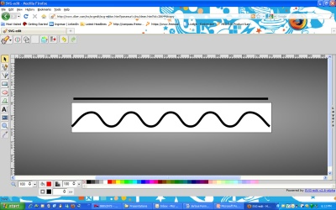
Embedded Measurement Engine Use Case
Sensor Examples: Pressure, Level, Proximity, Photodetector
PDB
SW
Filter
Sensor
TRIAMPS
OPAMPS
ADC
signal
ARM
Cortex M4 CPU
VREF
ACMP
External Peripheral
DAC
Ethernet
USB
signal
LCD CNTRL
SPI
External Bus Interface
Kinetis K50 device
Segment
Display
Graphic
Display
Sensors
Embedded Analog
Internal modules
Notes:
I think it’s worth quickly going over how we actually use the measurement engine? Our use case here is very simple and generic. Don’t worry the use cases later in the
presentation are much stronger. You have an analog signal coming from a sensor which could be industrial such as a temperature sensor, level sensor, proximity sensor,
pressure sensor or something very specific as the photodetector in a Pulseoximeter. This signal needs to be conditioned because the output of the sensor, especially
lower power ones require filtering and amplification just to identify the signal of interest. The analog signal comes from the sensor and is conditioned with op-amps and
tri-amps, it could be as simple as amplification or current to voltage conversion or building an instrumentation amplifier with internal circuits. We will explore such
applications later in the presentation with two very detailed use cases. Then the signal is passed to the ADC so it can be acquired and processed by the
microprocessor. The PDB is a very important block here because some sensors have very specific time windows to capture and the measure data. For example the
algorithm could take advantage of the PDB to read values depending on time like when you drive the LEDs in an Pulseoximeter application. The DAC also comes in
handy and its output could be used for another external peripheral or even to play some audio alarms in industrial applications. The point here is the measurement
engine is not only suitable for portable medical applications. It can be used in a wide variety of industrial or general purpose applications.
37

Slide 38
Embedded ADCs and Connections
SAR up to16-bit resolution
  Single or continuous conversions
  Hardware average (4,8,16,32)
  Selectable voltage reference
  (VREF, External)
  Programmable Gain Amp
  Automatic compare
  Configurable conversion speed
  Configurable sample time
  (short/long → resolution)
  Self-calibration mode
Internal connections with other modules
Low power modes
  VLPR (Very Low Power Run – Fully Functional, reduced clock 2Mhz)
  VLPW (Very Low Power Wait – Fully Functional, CPU clock stopped)
  STOP and VLPS – Fully Functional, Internal Clock
  LLS (Low Leakage Stop - Retains State)
  VLLSx (Very Low Leakage Stop - Powered Off)
PDB
PGA
VREF
ADC
DAC
OPAMP
TRIAMP
Notes:
Embedded Analog-to-Digital Converter (ADC)
SAR
The 16 bit successive approximation ADC (SAR) is a good fit for most portable medical applications like glucometers, EKG, blood pressure monitors, and Pulseoximeters.
Single/Continuous
The ADC is capable of single or continuous conversions, this allows flexibility while your measurement acquisition algorithm is in flux. A single conversion performs only one conversion. However there is an exception to this rule, if averaging is used. For this scenario a group of conversions is considered one conversion. A group is defined by hardware average setting. Continuous mode just performs one conversion after another. Again if averaging is used the average setting defines the group size.
Hardware Averaging
What is hardware averaging? Simply put the selected input is sampled and converted. Each result is then placed in an accumulator and an average is calculated . Once the selected number of conversions has been completed. The overall conversion is complete and a result is ready for processing by
the Microprocessor. This techniques helps increase the effective number of bits (ENOB).
Selectable VREF
There are two sources for VREF. The designer can select between an external or internal programmable VREF. This will be discussed later in the presentation.
Programmable Gain Amp
The Programmable Gain Amplifier (PGA) is designed to increase the dynamic range by amplifying low-amplitude signals before they are fed to the 16-bit SAR ADC. It can be configured for inverting and non-inverting modes. Gain ranges from 1 to 64 in (2^N) steps (1,2,4,8,16,32,64). The PGA is designed to work with differential inputs with input signal range from 0-1.2 V. There are up to two PGAs . This technique not only offers internal gain but reduces line interference and crosstalk found in PCBs. It also reduces component count.
Automatic Compare
The compare function compares the conversion to a compare value(s) and holds any conversion results until the condition has been met. This technique reduces microprocessor overhead. The processor does not need to read the result and compare to determine if the result is within a given range of interest. Automatic compare notifies the processor only when the range of interest has been satisfied.
Compares are as follows:
1. All conversions less than compare value are processed
2. All conversions greater-than or-equal-to a single compare value are processed
3. Less than or Equal Outside the range but not inclusive . Utilizes two compare values. So all conversions above the lowest compare value and below the highest compare value are processed
4. Outside the range inclusive
5. Inside the range but not inclusive
6. Inside the range inclusive
Configurable Sample Time
As I mentioned earlier the ADC can be configured as an 8, 10, 12, or 16-bit ADC for single ended inputs. The ADC also supports differential
inputs and can be configured as a 9, 11, 13, or 16 bit ADC. A slide coming up discusses this. Since the SAR is comparator based the sample
time decreases as the resolution decreases. Simply multiple the sample clock by the number of bits to get a basic idea how
long it takes for conversions .
Self Calibration Mode
Self calibration is done automatically and is used to compensate for internal gain and offset errors. A know voltage is applied to VIN and
processed by the ADC. In turn the result is fed into the 12 bit DAC and compared. Based on the results gain and offset corrections are
stored in compensation register to counteract these errors. The user also has the ability to write to registers to offset external gain and
offset errors. Obviously this technique is essential in terms of minimizing signal chain errors.
Internal Connections
The internal connectivity is displayed on the right side of the slide. The ADC has access to the DAC output, PGA output, tri-amp outputs,
and op-amp outputs. In turn the ADC feeds the PDC Block to initiate a possible trigger for another peripheral or receives a trigger from the
PDC to start a conversion. Internal connections also minimize any external noise found on PCBs like crosstalk and line interference. This
improves signal quality and reduces unwanted errors. So as you can see there is a ton of flexibility in terms of programmability and interconnect.
Low Power Mode
The ADC is operational in low power modes as well which makes it suitable for low power portable applications. You would not typical see low power
modes for external solutions. A very powerful technique.
1. Fully functional in the VLPR, VLPW low power mode.
2. Fully functional but can and must use only its own internal clock (ADACK) in the STOP and VLPS modes
3. Retains state in LLS mode
4. VLLSx modes - ADC turns off just like power off
Very Low Power Run (VLP Run) CPU Clock, System Clock and Bus Clocks maximum frequency is restricted to 2MHz max.
Very Low Power Wait (VLP Wait) CPU Clock is shut off. System Clock continues to operate and Bus Clocks if enabled continue to operate; System and Bus clock restricted to 2MHz max. 4us recovery time
Stop CPU is in static state. Lowest power mode that retains all registers while maintaining. WIC is used to wake up from interruptions - 4us recovery time
Very Low Power Stop (VLP Stop) CPU is in static state. Lowest power mode with ADC and DAC. 4us recovery time
Low Leakage Stop (LLS) CPU is in low leakage state retention power mode. 4us recovery time.
DMA Engine and PDB
The DMA engine, Programmable Delay Block (PDC) are integrated together to offload the microprocessor. In fact the primary trigger
is the PDC block but another peripheral can trigger the ADC indirectly thru the PDC. A few examples include the real-time clock, high speed
comparator, Periodic Timer, or Flex timer .A conversion is started or triggered by software, the time of day module, or the programmable delay
block. The slide illustrates how the ADC can be connected internally to several modules within the measurement engine. The ADC is operational
in low power stop modes for additional power savings.
Analog to Digital Converter (ADC) - Internal Connections
If you look at the diagram on the right you’ll notice ADC0 and ADC1 internal connections are very different. ADC0s three options are DAC0
output and both Op-Amps . ADC1s three options are DAC1 output , transimpedance amp1 and VREF. Keep in mind the internal signals are
key in terms of reducing the effects of external noise sources (line interference). The external inputs will be discussed in the next slide.
38

Slide 39
Embedded ADC Internal Connections
Internal Connections
DAC0
ADC0 single ended inputs
  DAC0 output
  OPAMP0 output
  OPAMP1 output
ADC1 single ended inputs
  DAC1 output
  TRIAMP1 output
  Voltage Reference output
ADCx Hardware trigger
  PDB channel 0 triggers ADC0
  PDB channel 1 triggers ADC1
OPAMP0
ADC0
OPAMP1
PDB
DAC1
ADC1
TRIAMP1
VREF
Notes:
If you look at the diagram on the right you’ll notice ADC0 and ADC1 internal connections are very different. ADC0s three options
are DAC0 output and both Op-Amps . ADC1s three options are DAC1 output , transimpedance amp1 and VREF. Keep in mind the
internal signals are key in terms of reducing the effects of external noise sources (line interference). The external inputs will be
discussed in the next slide.
39

Slide 40
Embedded ADC Single-Ended Channels
Possible resolutions: 16-bit, 12-bit, 10-bit, and 8-bit modes
ADC0
ADC1
21 single-ended analog inputs
18 external channels
22 single-ended analog inputs
19 external channels
Notes:
Embedded Analog to Digital Converter Single-Ended Channels
This slide talks about the single ended inputs that are available for both ADC (ADC0 and ADC1). As I mentioned earlier there
are 24 single ended inputs available for each. So why does the slide say there are 21 for ADC0 and 22 for ADC1? Let me explain.
ADC0
ADCO has access to18 single ended external pins . Then there are the 3 internal single ended signals that come from
internal peripherals. To be more specific OPAMP0 and 1 and DAC0 output. The VREFH , VREFL (Voltage Reference high
and low) and Temp sensor inputs utilize the last 3 inputs for a total of 24 .
ADC1
ADC1 is slightly different. It has access to 19 single ended inputs. How come 19? What’s different? If you look to the
right of ADC1 you’ll notice there is a signal called VREFO. VREFO is a programmable internal Voltage (1.2V). This is an
optional VREF to ADC1 and sense only one reference can be used at a time it’s multiplexed with VREFH. This frees up
one input for a total of 19 ext pins, 2 VREF inputs , 1 Temp sensor input and 2 internal peripherals. By the way the
internal peripherals are DAC1 and transimpedance amp1 outputs.
Temp Sensor
The ADC module includes a temperature sensor whose output is connected to one of the ADC analog channel inputs.
40

Slide 41
Embedded ADC Differential Pair Channels
Possible resolutions:
Differential 16-bit, 13-bit, 11-bit and 9-bit modes
Single-ended 16-bit, 12-bit, 10-bit and 8-bit modes
4 Differential pairs, 2 PGA Differential pairs
Notes:
The differential pairs are a great technique to reduce noise in the system. It’s invaluable in portable medical
applications as the noise or line interference (50/60Hz AC noise) is significant. The two use cases will talk about
this later in the presentation. In differential mode the ADC can be configured as a 9-bit, 11-bit, 13 bit, or 16-bit ADC.
You may ask why the odd number of bits compared to single ended inputs. The reasoning for this is based on the ADCs reults.
In differential mode the result is 2’s complement. There are 4 differential pairs for ADC. DP represents the positve signal and
DM represents the negative side.
41

Slide 42
Embedded ADC Interleaved Channels
Two ADC’s cover the same external pin
    Higher speed rate
    Better efficiency
    More flexibility
    Frequent calibration without stop measurements
Notes:
Interleaving sampling – Interleaving sampling - Interleaving sampling – Simply put two ADCs perform conversions on the same
external pins. In affect the user is sampling the signal at 2x. The inputs are independently connected to ADC1 and ADC0. If ADC0 starts
a conversion on pin L1, ADC1 can start sampling the same pin PRIOR to ADC0 conversion complete. This can double the speed of the ADC.
42

Slide 43

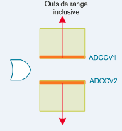
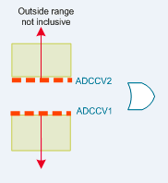

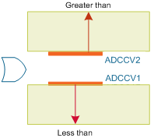
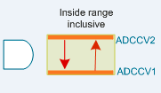
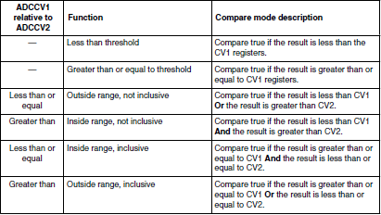
Embedded ADC Automatic Compare
Integrated Analog Technique That Compares Conversion
Results And Sets A Trigger Event
  Less than threshold - #1
  Greater than or equal to threshold #2
  Outside range (not inclusive #3, and inclusive #6)
  Inside range (not inclusive #4, and inclusive #5)
4
Greater than or Equal to Threshold
4
1
2
Less than Threshold
6
6
Not Inclusive
3
5
1
2
3
4
5
6
Notes:
43
43
Embedded Automatic Compare
The compare function is used to hold off the ADC conversion complete until a result falls within a range specified by the microprocessor.
Without this function the microprocessor would need to read every conversion and then determine if the conversion value is of interest
or falls within the range of interest. As you can image values outside the range of interest are simply tossed aside
and valuable processing time is wasted. Holding off conversion complete increases micro efficiency and decreases micro or CPU overhead.
There are six modes of operation as described in the table above and waveform scenarios. The numbers to the left of the table identify
each of the six modes which in turn are identified in the diagrams above.
Less Than Threshold - Any conversions below the compare value (CV1) is stored in the result register and conversion complete is set
Greater than or Equal to Threshold - Any conversions above or equal to the compare value (CV1) is stored in the result register and
conversion complete is set
Two compare values are used for modes 3-6
3. Outside Range non-inclusive , less than CV1 or greater than CV2 -Any conversion less than CV1 or greater than CV2 is stored
in the result register and conversion complete is set. Note the compare value end points are not stored (endpoints =values in CV1 and
CV2) which makes this non-inclusive.
4. Inside Range non-inclusive, less than CV1 and greater than CV2 -Any conversion less than CV1 or greater than CV2 is stored
in the result register and conversion complete is set. Note the compare value end points are not stored (endpoints =values in CV1
and CV2) which makes this non-inclusive.
5. Inside Range, inclusive, greater than or equal to CV1 and less than or equal to CV2 - Any conversion greater than or equal
to CV1 or less than or equal to CV2 is stored in the result register and conversion complete is set. Note the compare value end points
stored (endpoints =values in CV1 and CV2) which makes this inclusive.
6. Outside Range , inclusive , greater or equal to CV1 or less than or equal to CV2 -Any conversion greater than or equal
to CV1 or less than or equal to CV2 is stored in the result register and conversion complete is set. Note the compare value end
points are stored (endpoints =values in CV1 and CV2) which makes this inclusive.

Slide 44
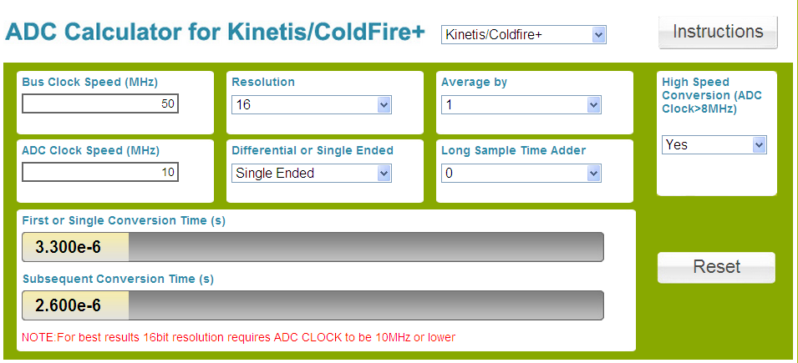
Embedded ADC Conversion Speed Calculator Tool
How do I calculate my conversion speed ?
http://www.freescale.com/webapp/sps/site/overview.jsp?code=ADC_CALCULATOR&tid=mKhp
ADC Calculator
Notes:
ADC Conversion Speed Calculator
There are many software tools out there to assist in the ADC selection process . This is just one technique
to help the designer during the evaluation process. This spreadsheet is available on WIKI. It’s a tool that allows
you to calculate conversion speed. It is very easy to demo. The information you will need to supply
is the Bus Speed and ADC clock speed. Based on these two numbers you can calculate the conversion time. You can
calculate single and differential conversions times . You even have the flexibility to vary the average setting . Give it a try!!
44

Slide 45
Embedded ADC Voltage Reference
 | Min | Max
Supply voltage V_{DDA} | 1.71 V | 3.6 V
Delta to V_{DD} (V_{DD} - V_{DDA}) | -100 mV | +100 mV
Delta to V_{SS} (V_{SS} - V_{SSA}) | -100 mV | +100 mV
VREFH | 1.13 V | VDDA
VREFL | VSSA | VSSA
Each pair is connected to a positive reference (V_{DDA}) and a ground reference (V_{SSA})
Notes:
45
45
At first glance this slide is a bit confusing but what it tries to illustrate is the fact that there at two VREF sources to select from. One is an
external VREF (external pins) and the second is a programmable 1.2V internal VREF. VREF consists of voltage reference pairs. Each pair
has a high voltage reference (H) and low voltage reference (L). The low voltage should always be referenced to VSSA (analog GND).
Selection is controlled by a configuration register in the Microprocessor
If VREF external is selected: (VREFH, VREFL)
VREFH (High) external pin can be set to a value from 1.13-3.6V.
VREFL (Low) is set to VSSA (analog GND)
If VREF internal is selected
VREFO (High) is a programmable voltage up 1.2V in 5mV steps
VREFL (Low) is set to VSSA (analog GND)
You’ll notice the specs are listed for the external VREF (VREFH, VREFL) but the internal VREF specs are not. This will be covered in a few slides

Slide 46
Embedded Digital-to-Analog Converter
VDDA
DAC0_OUT
12-bit digital input
On-chip programmable reference generator output
Selectable reference voltage
Supply an accurate constant (fixed) voltage output as reference for on-chip analog peripherals
Configurable trigger source
16 word data buffer
FIFO for DMA support
Configurable watermark
Static operation in normal Stop mode
PDB
ADC0
DAC0
CMP1
OPAMP0
OPAMP1
DAC1
CMP2
VREF
ADC1
DAC1_OUT
Notes:
46
12 bit DAC
The 12-bit DAC can be used by a variety of applications from biasing glucose test strips to sampling audio, the
DAC can be used as a programmable reference generator for modules like the ADC or the OPAMP. It's designed
to be a low power general purpose DAC. The output of the DAC can be placed on an external pin or set as one
of the inputs to an analog comparator, Op-Amp, ADC, or other peripheral.
On-chip VREF and Selection
It can be configured to use an external VREF (VDDA) or internal Trimmable VREFO. Selecting the internal VREF
enables higher accuracy measurements, although the output voltage value is limited to VREF input. Voltage
accuracy can be adjusted through a trim register for fine tuning your application.
When input reference selects VDDA, monotonic operation is guaranteed while VDDA is between 1.71 V and 3.6 V.
When input reference selects VREF output , monotonic is guarantee while VDDA is between 2.4 V and 3.6 V.
Configurable Trigger Source and FIFO operation
There is a 16 word FIFO that can utilized to build analog waveforms. The FIFO is 12 bits (word) wide and increments
or decrements a read pointer under software or PDC control (event trigger). Modes of operation are as follows:
Non buffer – the buffer FIFO is bypassed, As soon as you write to the output register the output changes automatically.
Buffer Normal Mode -This is the default mode. The buffer works as a circular buffer. The read pointer
increases by one, every time a trigger occurs. When the read pointer reaches the upper limit, it goes to the zero
directly on the next trigger event.
Buffer Swing Mode
This mode is similar to the normal mode. But when the read pointer reaches the upper limit, it does not go
to the zero. It decrements the pointer by one on the next trigger event until zero is reached.
Buffer One-time Scan Mode
The read pointer increases by one every time a trigger event occurs. When it reaches the upper limit,
it stops. If the read pointer is set to an address other than the upper limit, it will increase to the upper
address and stop at there again.
DMA
Like the ADC the DMA engine can be used to offload the microprocessor and perform writes to the 16 word FIFO.
Configurable watermark
The DAC has 3 interrupts that will trigger once the bottom of the buffer is reached, once the top of the buffer
is reached or once a configurable watermark value is reached.
46

Slide 47
Embedded Programmable Delay Block (PDB)
Provide controllable delays
  One Shot
  Continuous
  Back-to-Back
  Synchronize multiple ADC’s
Hardware trigger to the DAC
External trigger inputs
  Analog comparator
  ADC conversion complete
  Software
  Previous channel acknowledge
  Timers
CMP2
CMP1
CMP0
PDB
DAC0
ADC0
DAC1
ADC1
Notes:
Programmable Delay Block – Provides controllable delays Allows timing control for ADC conversions – Basically provides ADC conversion scheduling with a
4 register delay. Provides trigger output to advance the DAC buffer pointer. Is a timer with: Counting register or Modulo register
So lets tie all these timers together – Periodic Interrupt Timer, FlexTimer, and Programmable Delay block – When do I use what and Why??
The periodic interrupt timer is pretty simple. At some given interval an interrupt is generated. Let’s say every 100uses. A typical use
case for this might be an ADC conversion. So every 100usec you enter an Interrupt Service routine and start an AD conversion and some
time later you get a result. This is all well a good but requires software intervention to accomplish this. The user must enter a service routine
start the conversion and exit. This is time consuming, the CPU’s time could be spent doing other task and computations. Thus the need for Hardware timers.
Hardware Timers – We have two choices – FlexTimers and Programmable Delay Blocks. The FlexTimers are used when you need to generate
output waveforms or examine inputs based on time. A good example is PWM generation. PWM signals could be used to dim an LED. It could also
be used in a switch mode supply topology or DC to DC converter (step down converter). One of the methods used in a step down converter is
to vary the duty cycle. In affect varying the duty cycle has a direct correlation on the output voltage. For example if your Vin is 24 volts and your
duty cycle is 20% the step down voltage is roughly 20% or 4.8V. Of course the classic case is to use PWM for motor control. Maybe you need to
know how quickly something is rotating and in what direction. A good example might be the volume control on your car radio or knob that changes
the radio frequency. The FlexTimer could be used to determine if the volume needs to be turned up or down based on direction and how quickly
should the volume change. Maybe you need to determine how wide a pulse is? Input capture could be used for this. Save the count in the timer
on the rising edge and then save the count in the timer again on the falling edge. Subtract one from the other to determine a relative time from
rising to falling edge. Maybe you need to generate a pulse at some determined width. Output compare could be used for this. You could use the
FlexTimer to start ADC conversions and obtain the result. All this is done in hardware to offload the CPU. Minimal CPU intervention is required,
mostly for set-up and reading results. The Programmable Delay Block is somewhat similar to the FlexTimer. It’s still hardware based and can
act as a counter but adds in the ability to delay functions. For example maybe the user would like to start an AD conversion on one channel and
then start another conversion some time later on a second channel. Maybe the user would like to start an AD conversion when a comparator
detects a voltage above a given reference for some given period of time (settling time). Another example the DAC could be used to build complex
waveforms based on the values in the DAC word FIFO. The FlexTimer can be used to increment the pointer buffer to build a ramp function or
sinusoidal waveform on the FlexTimer’s channel output. So as you can see each timer function is very flexible and can be combined to
Solve/ build very complex functions.
47

Slide 48
Embedded Voltage Reference Module (VREF)
1.2 V output @ 25° C
Dedicated output pin for off-chip peripherals (VREFO)
  Maximum load of 1.1 mA
  If high current is demanded a 100 ηF capacitor needs to be connected to V_{REFO}
  Provides an accurate reference voltage to off chip modules
Internal Voltage Reference for On-chip peripherals
  For both DAC’s (0 and 1)
  ADC1 single ended channel
  Analog comparator 0 and 1 (CMP)
Programmable trim register to correct for process and temperature variation
  0.5mV steps
Internal Vref improves ADC and DAC resolution by 3X
VREFO pin
DAC0
VREF
DAC1
ADC1
CMP0
CMP1
Notes:
48
VREF Module
The VREF module is intended to supply an accurate constant (fixed) voltage output as a voltage reference to on-chip analog peripherals or
off-chip external peripherals. The dedicated out pin is called VREFO. We talked a little bit about this output when we covered the ADC and
it’s VREF and input options. When used externally the max current load is 1.1mA. A good design technique would be to install a 100nF
capacitor from VREFO to ground. On-chip peripherals that use VREF include ADC1, both DACs, and both Programmable Analog Comparators.
Conventional bandgap voltage reference s have a larger deviation over process ,voltage, and temperature. This VREF provides corrective
trimming to improve reference voltage accuracy. A trim register is provided for the user so that VREF output voltage can be fine tuned to
as close to as 1.2V,. The trim registers allows for 0.5 mV steps. ADC sampling resolution can have three times the improvement if ADC voltage reference is VREF instead of VDD. Another great technique Embedded analog can provide.
Note: Using VREF for DAC and ADC together is not recommended. Noise issue
48

Slide 49
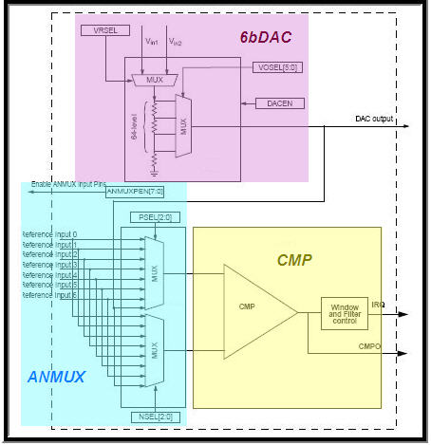
Embedded Analog Comparators
High-speed comparators
  Continuous, sampled, windowed modes
  Selectable inversion on comparator output
  Programmable filter and hysteresis
Two 8 input analog muxes
  Positive/negative input selection
External pin inputs and several internal reference options including 6bDAC, 12bDAC, bandgap, VREF, OpAmp, TRIAMP
6-bit DAC for programmable reference
  Output range (Vin/64) to Vin
  VREF or VDD selectable as DAC reference
Comparator Block Diagram
Notes:
Embedded Analog Comparator
The Comparator are used to compare two analog input voltages (INP and INM). The analog comparator output (CMPO) is high
when the non-inverting input is greater than the inverting input, and is low when the non-inverting input is less than the inverting
input. The comparator output supports inversion as well. An optional interrupt (IRQ ) is generated on the falling or rising edge
of the comparator output. The comparator can operate in three different modes: Continuous, Sampled, Window.
Continuous Mode - Allows the comparator output to change immediately (pass through mode). The comparator output is not
clocked therefore it is not sampled or filtered and is updated immediately.
Sampled Mode – Unlike continuous mode the comparator output is synchronized to an internal or external clock (clocked
on the rising edge of clock). The comparator output is updated on the rising edge of clock.
Sampled Filtered Mode – Like sampled mode the comparator output is sampled with every rising edge of clock but is not
updated immediately. A number of consecutive matching samples (same state samples) must occur before the comparator
output is updated to a new output state (logic 0 or logic 1). The filter counter is programmable from 1 to 7 samples (i.e. count = 6,
the comparator output would have to remain at the same state for 6 consecutive samples before being updated)
Window Mode - Window mode uses a window sample signal. When the window sample signal is high the comparator output
operates like continuous mode (pass through) and the output is updated. When the window sample signal is low the previous
comparator value is retained. Window sample signal is an internal signal tha is generated by the Programmable Delay Block (PDC).
Window Mode Resample – The same as window mode except the comparator output is sampled with the rising edge of clock
and updated only when the window signal is logic 1. In addition interval sampling can be used in conjunction with the window signal
to define a timed based sampling period when the window signal is logic 1. Interval sampling is defined by the period counter and is
basically a time based sample window within the window. The comparator output maintains the previous state when the window signal goes
to logic 0.
Window Mode Filtered – The same as window mode resample except that the filter counter is used instead of the interval/period
counter. A number of consecutive matching samples (same state samples) must occur before the comparator output is updated to a
new output state (logic 0 or logic 1). The comparator output maintains the previous state when the window signal goes to logic 0.
Hysteresis – There are 4 levels of hysteresis.
Comparator module - (CMP) provides a circuit for comparing two analog input voltages. The comparator circuit is designed to
operate across the full range of the supply voltage (rail to rail operation).
Analog MUX - (ANMUX) provides a circuit for selecting the comparators analog input signals. There are eight channels to select from.
One signal provided by the 6-bit DAC. The mux circuit is designed to operate across the full range of the supply voltage.
6-bit DAC - (6bDAC) is 64-tap resistor ladder network which provides a selectable voltage reference for the comparator.
The 64-tap resistor ladder network divides the supply reference Vin into 64 voltage level. A 6-bit digital signal input selects output
voltage level, which varies from Vin to Vin/64. Vin can be selected
from two voltage sources, Vin1 and Vin2. The 6-bit DAC from a comparator is available as an on-chip internal signal only and is
not available externally to a pin.
The comparator inputs and outputs are programmable and very flexible. Comparator inputs have 8 different connection
options: VDD, GND,DAC0, DAC1, 6b DAC Vref, adjacent OPAMP output. The comparator output has three routing
options: Output pin or adjacent comparator input or ADC input. The output also supports inversion
49

Slide 50


Embedded Trans-Impedance Amplifier (TRIAMP)
2 trans-impedance amplifiers
Can be used as general purpose op-amps.
Low-input bias current (Typical at +/- 300ρA)
Input voltage range: -0.2 V to VDD-1.4 V
Output voltage range:0.15 to VDD-0.15V
Output connected other on-chip analog modules
ADC1
OPAMP1
TRIAMP1
TRIAMP0
CMP2
Notes:
50
Transimpedance Amp
The tri-amp block is CMOS based with a single supply, low input offset voltage, low input offset and bias current amplifier that is designed
for low-voltage, low-power operation. You’ll notice the tri-amp is very similar in terms of specs and design when the op-amps are covered
on the next slide. I should mention the tri-amps and op-amps are what differentiate the K50 family from the other Kinetis solutions. There
are up to transimpedance amplifiers. They can be used as general purpose op-amps or for specific applications like a photodiode. For this
type of application the tri-amp supports a zero biased and reverse biased operation. In our Pulseoximeter use case we will utilize the tri-amp
as part of the signal chain where current from a photodiode is converted to voltage and amplified.
50

Slide 51
Embedded Operational Amplifier (OPAMP)
Configurable inputs
2 operational amplifiers
Programmable voltage gain
Selectable configuration modes
  Non-inverting
  Inverting
  Buffer
  General purpose
Input offset voltage(+-3mV)
Low-input bias current (+-300 pA)
DAC
OPAMP
ADC
Notes:
51
Operational Amplifier
The measurement engine has 2 general purpose operational amplifiers. This is key because most portable medical applications
require signal filtering or amplifying. This will be covered later in the presentation by the EKG and Pulseoximeter use cases. The op-amp
block is CMOS based with a single supply, low-input offset voltage, low-input offset, and bias current amplifier that is designed for
low-voltage, low-power operation over an input voltage range of 0 to supply (3.6V).
Configurable inputs
The inputs in the op-amp block can be configured in such a way that the DAC can provide signal to the op-amp, this means the designer can
have one external signal and an analog reference signal supplied by the DAC. Additionally VDD, VSS, and both op-amp outputs can be used as an input.
Programmable Voltage Gain
Each op-amps has a programmable voltage gain that can vary from 1 to 17 values with some fractional values in the middle.
This is really convenient when designing for signal instrumentation. It’s convenient because gain is adjusted by software instead of changing external
resistors allowing easier fine tuning of your application. A programmable resistor network is used to change the gain. A great technique that Embedded Analog offers.
Modes of Operation
Each op-amps can be configured for several modes,:
amplifier mode -
buffer mode – Gain of one
inverting mode – inverting configuration with programmable gain. Gain is defined by software and utilizes an internal programmable resistor network.
non inverting mode – non-inverting configuration with programmable gain. Gain is defined by software and utilizes an internal programmable resistor network.
Input Offset Voltage
The input offset voltage goes as low as 3 mV, this would be the measured output voltage when input terminals are shorted,
the offset voltage in an ideal op-amp would be 0 volts. The offset current is as low as 200 pA. Again good specs for small signal environments
That require amplification with minimal gain and offset errors.
Low Bias Currents
Another important parameter to consider is the low input bias current, which is defined as the average of the currents of the two inputs.
It’s +/- 300 pA . This is a very important technique when selecting an op-amp when with small signals and amplification. This will be covered in the
EKG use case
51

Slide 52
K50 Family Block Diagram
Clock Module:
2 Crystal inputs
2 internal
oscillators
PLL and FLL
Secure
Digital
Host
Controller
16-ch
DMA
Segment
LCD cntrl.
LS/FS
USB
(H/D/OTG)
with DCD
IEEE 1588
Ethernet
MAC +
Hardware Encryption
ARM Cortex-M4 Core
and DSP @
1.25DMIPs/MHz
CrossBar Switch (XBS)
Memory Protection Unit
Flash
Memory
FlexBus
Peripheral Bus Controllers (x2)
SRAM
Measurement Engine
Analog
Timers
Communications
Motor Control or
General Purpose
PWM
1 x 8 ch
Quad Encoder or
General Purpose
PWM
2 x 2 ch
Flex
Memory
3 x FlexTimers
2x I²C
UART
DSPI
I²S
2x16-bit ADC with 2x PGA
Real Time Clock
with Vbat
Legend
Programmable
Interrupt Timer
RTC 32 KHz + VBAT
2x 12-bit DAC
Internal VRef (1.2V)
2x TRIAMP
2x OPAMP
K52 and K53 only
Low Power
Touch Sense
Interface
Low Power Timer
K51 and K53 only
Programmable
Delay Block
Crypto (CAU + RNG)
Analog
IEEE1588 Timer
1 x 4 ch
Up to 96 GPIO
-40ºC to 85ºC temperature range
Notes:
52
52
This is where we reveal everything we just talked about is in the Kinetis K50 Family
Highlight the Measurement Engine IP
Feel free to talk about any other components in the K50 Processor

Slide 53
K50: ADC Package Configuration Options
part # | Package | PGA | ADC0 | ADC1 | MAX SE | MAX DP
K51X128 | 64 LQFN 64 LQFP | 1 | 15 SE + 1 DP | 8 SE + 2 DP | 16 | 2
K50X128 | 64 LQFP 64 LQFN | 1 | 15 SE + 1 DP | 12 SE + 2 DP | 20 | 2
K50/K51 X128/256 | 80 LQFP 81 BGA | 2 | 19 SE + 3 DP | 16 SE + 3 DP | 23 | 4
K50X256 | 100 LQFP | 2 | 19 SE + 3 DP | 18 SE + 3 DP | 23 | 4
K51X256 | 100 LQFP | 2 | 19 SE + 3 DP | 19 SE + 3 DP | 24 | 4
K50/K51 X256 | 121 BGA | 2 | 19 SE + 3 DP | 20 SE + 3 DP | 25 | 4
72 MHz
part # | Package | PGA | ADC0 | ADC1 | SE | DP
K50/K51 X256 | 81 BGA | 2 | 19 SE + 3 DP | 16 SE + 3 DP | 18 | 4
K50X256 / K50N512 | 100 LQFP | 2 | 19 SE + 3 DP | 18 SE + 3 DP | 18 | 4
K51X256 / K51N512 | 100 LQFP | 2 | 19 SE + 3 DP | 19 SE + 3 DP | 18 | 4
K50/K51 X256 K50/K51 N512 | 121 BGA | 2 | 19 SE + 3 DP | 20 SE + 3 DP | 20 | 4
K50/K51 X256 | 80 LQFP 81 BGA | 2 | 19 SE + 3 DP | 16 SE + 3 DP | 23 | 4
K51N256 K52/53 N512 K53X256 | 144 LQFP 144 BGA | 2 | 21 SE + 3 DP | 22 SE + 3 DP | 25 | 4
100 MHz
DP – Differential Pairs
SE – Single Ended
Notes:
This slide illustrates all the combinations of analog IP and pin outs for each package and speed of the K50.
You’ll notice there are two columns on the extreme right side of the slide. These columns define the max number of
single ended and differential pairs that can be used if both ADCs are utilized. There are restrictions because of the
pin muxing and common external pins for each ADC. This slide really does a good job defining the different analog options for
the K50 family – K50, K51, K52, K53
53

Slide 54
Kinetis Product Family Features
MCU
Family
LCD (Segment/Graphics)
Hardware Tamper Detect
NAND Flash Controller
Encryption (CAU+RNG)
Measurement Engine
USB OTG (FS & HS)
Ethernet (IEEE 1588)
Floating Point Unit
DRAM Controller
Dual CAN
Common System IP
32-bit ARM Cortex-M4 Core w/ DSP Instructions
Next Generation Flash Memory High Reliability, Fast Access
FlexMemory w/ EEPROM capability
SRAM
Memory Protection Unit
Low Voltage, Low Power Multiple Operating Modes, Clock Gating (1.71V-3.6V with 5V tolerant I/O)
DMA
Common Analog IP
16-bit ADC 12-bit DAC
Programmable Gain Amplifiers
Op-Amp TriAmp
High-speed Comparators
Low-power Touch Sensing
Common Digital IP
CRC
I²C
SSI (I²S)
UART/SPI
Programmable Delay Block
External Bus Interface
Motor Control Timers
eSDHC
RTC
Development Tools
Bundled IDE w/ Processor Expert
Bundled OS USB, TCP/IP, Security
Modular Tower H/ware Development System
Application Software Stacks, Peripheral Drivers & App. Libraries (Motor Control, HMI, USB)
Broad 3rd party ecosystem
K70 Family 512KB-1MB, 196-256pin
K60 Family 256KB-1MB, 100-256pin
K50 Family 128-512KB, 64-144pin
K40 Family 64-512KB, 64-144pin
Op-Amp
TriAmp
K30 Family 64-512KB, 64-144pin
K20 Family 32KB-1MB, 32-144pin
K10 Family 32KB-1MB, 32-144pin
K50 Additional Analog
Notes:
54
K50 Sampling - Q4 2011 (50/72MHz)
Measurement Engine IP - Common Analog IP plus Op-Amp and TriAmp (K50 Branded IP)
Kinetis Family Overview
COMMON SYSTEM IP
ARM CORE: 50-180MHz CPU
Next Gen Flash: TFS (Thin Film Storage) benefits with low power, 4-level security protection. Independent flash banks allow concurrent code execution and firmware updating
FlexMemory: 32bytes-16KB of EEPROM. In addition to EEPROM there is 32KB–512KB of FlexNVM for extra program code, data or EEPROM backup (EEPROM backup is a method used for EEPROM wear levelling to achieve 10 million cycles)
SRAM: up to 128KB (4:1 ratio -- 4 times more Flash than SRAM) – also referred to as Tightly Coupled Memory (TCM)
Memory Protection Unit (MPU): provides memory protection for all cross bar switch masters, increasing software reliability. MPU monitors bus transactions based on control access. If access is denied (protected) the transaction is terminated. Please do not confuse the MPU with MMU (Memory Management Unit) which is required for WinCE or Linux support. There is no MMU offered in any of the Cortex M series processors (M0,M1,M3,M4).
Low Power
Modes: 10, flexible peripheral activity and wakeup times. Expanded granularity over the standard CortexM4 modes.
Voltage: Operation from 3.6V down to 1.71V
5V tolerant: I/O on vast majority of devices
32ch DMA: up to 32 channel DMA for peripheral and memory servicing with reduced CPU loading.
Temp: -40 to 105C
Packages: QFN: 32 (5 x 5mm), 48 (7 x 7mm), 64 (9 x 9mm) LQFP:48 (7 x 7mm), 64 (10 x 10mm), 80 (12 x 12mm), 100 (14 x 14mm) 144 (20 x 20mm) MAPBGA:81 (10 x 10mm 1.0), 104 (10 x 10mm .8), 144 (13 x 13mm 1.0), 196 (15 x 15mm 1.0), 256 (17 x 17mm 1.0)
LQFP - Low-profile Quad Flat Package MAPBGA - Molded Array Process Ball Grid Array
ANALOG IP
16 Bit ADC: High-speed, configurable
Differential operation for improved noise rejection (up to 2) – Single ended operation supported - unipolar
PGA: Programmable Gain Amplifier support for small amplitude signal processing with x64 gain (1 per ADC)
12-bit DAC: analog signal generation i.e.. for audio applications. Internal connection to other peripherals or to external pin
High-speed Comparators: K50 Only - can provide fast, accurate motor over-current protection (drive PWMs to safe state)
Op-Amp: Covered in earlier Slides
TriAmp : Covered in earlier slides
Touch Sense Input: button, rotary and slider user interfaces operates in ALL low-power modes with minimal current added. Supports up to 16 inputs.
DIGITAL IP
CRC engine, I2C & I2S interfaces
UART: Multiple ports with many data size, format and transmission settings supported
Programmable Delay Block: enables timing synchronization between multiple internal or external peripherals – some examples of uses listed below
Sample ADC module without CPU interrupt, decrease CPU load and save power
In general motor control, measures voltages and currents for synchronizing the FlexTimer PWM and the ADC module
External Bus Interface: for interconnection of ext. peripherals & memories i.e. graphics LCDs. Up to 6 CS, up to 2GB addressable memory
Flex Timer Module: for motor control and power management applications but also retains standard timer features such as output compare or input capture functions.
In motor control environments the FlexTimer provides complementary signal generation, hardware dead time generation, mask, polarity and fault control capabilities – features typical of dedicated PWM modules.
eSDHC: connection to SD, SDIO, MMC or CE-ATA cards for in-application software upgrades, file systems or adding Wi-Fi or Bluetooth support
RTC: Real Time Clock – Independent power supply (allows for separate battery operation), POR and 32 kHz crystal oscillator
FS: Full Speed USB – 12Mbps
HS: High Speed USB – 480Mbps
CAN: Supports the full implementation of the CAN Specification Version 2.0, Part B
Ethernet: capability 10/100 MB/s Ethernet MAC (MII and RMII) with hardware support for IEEE 1588
IEEE 1588: - is a high-precision time protocol for synchronization in a local area network (Ethernet). Accuracy in the sub-microsecond range may be achieved with low-cost implementations.
I2S: is a full-duplex, serial port that allows the chip to communicate with a variety of serial devices, such as standard codecs, digital signal processors (DSPs), microprocessors, peripherals, and audio codecs that implement the inter-IC sound bus (I2S) and the Intel® AC97 standards
I2C: Allows communication between a number of devices. Also supports the System Management Bus (SMBus) Specification, version 2.
USB OTG: USB 2.0 compliant module with support for host, device, and On-The-Go modes. Includes an on-chip transceiver (phy) for full and low speeds.
CAU: Cryptographic acceleration unit, Supports DES, 3DES, AES, MD5, SHA-1, and SHA-256 algorithms via simple C calls to optimized security functions provided by Freescale.
RNG: Radom Number Generator, Supports the key generation algorithm defined in the Digital Signature Standard.
Bundled OS: Free Freescale MQX RTOS
IDE : An integrated development environment (IDE) used for software development and debug - Code warrior or IAR Embedded WorkBench or Keil ARM MDK (Microcontroller Development Kit)
Processor Expert : used in conjunction with Code Warrior (GUI interface used to define and parameterize hardware peripherals), Processor Expert creates a Hardware Abstraction Layer (HAL) and hardware-dependent low-level drivers.
HMI: Human Machine Interface – refers to capacitive touch in Kinetis

Slide 55
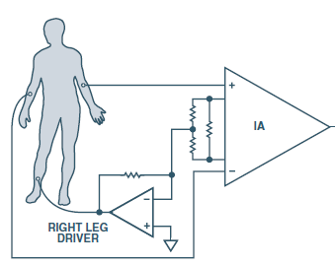



Use Case: Medical EKG Analog Front End
Instrumentation Amp
Low pass Filter
150hz
Gain OP AMP
50/60Hz
Notch Filter
16 bit ADC
K50 Connectivity Engine
Processing Engine
USB, Ethernet, SPI
LCD Controller
TriAmp
OpAmp
TriAmp
Right Leg Driver
K50 Measurement Engine IP
Techniques To Eliminate Input Offset/Noise
Instrumentation Amp
Eliminates part of 50/60Hz noise because of
large Common Mode Rejection Ratio (CMRR)
High Impedance Inputs
Low Input Bias Current (+/- 300pA)
Low Input Voltage Noise (90nV/rt-Hz)
Right Leg Driver
Eliminates common mode interference
Inverted version of common mode interference driven
back into patients leg to cancel interference
Low Pass Filter
0.5Hz to 250Hz
Programmable Gain Amp
Amplify filtered signal - second stage amplifier
50/60Hz Notch Filter
Eliminate 50/60Hz noise
External Component
EKG Signal Characteristic
Electrode Signals 0.05-10mV
EKG Offset and Interference Noise
EKG Signal sits on these offsets
  Filtering required to extract electrode signals
Common Mode Offset/Interference
  Noise introduced into the system due to patient
  environment (0-1.5V, 50/60Hz AC Line noise)
Electrode Offset +/- 300mV
  Caused by dynamic resistance due to perspiration
  and or electrode gel drying characteristics
Notes:
EKG Description (http://cache.freescale.com/files/analog/doc/app_note/AN4323.pdf?fsrch=1&sr=3)
The heart pumps blood through the body via a sequence of mechanical events . Each mechanical event is controlled by an electrical event.
An Electrocardiogram (EKG or ECG) monitors and or records these electrical events through the skin. When an electrical event occurs, an
electrical current is conducted to the bodies surface/skin. Electrodes attached to the skin in certain areas of the body (triangle configuration
shown in diagram – left arm, right arm and right leg) measure these currents (pulses). Heart rate in its basic form is based on the time between
pulses. EKGs can also monitor blood pressure based on the amplitude of each pulse. High blood pressure tends to increase the amplitude of
these pulses significantly. Basic EKG monitoring consists of a minimum of 3 -5 leads. 3-5 lead EKGs tend to be monitored continuously and
viewed only on a screen. A typical 3-5 lead device is used during an operation or during transport in an ambulance. A typical diagnostic EKG
has 12 leads. A 12 lead EKG is one in which 12 different electrical signals are recorded at approximately the same time and will often be used
as a one-off recording of an EKG for analysis, traditionally printed out as a paper copy. A physician’s assistant performs the EKG which can be
reviewed and analyzed by a physician at a later date to determine heart health and condition.
Embedded vs. External/Discrete
Let me first state that the embedded vs. external decision depends on system requirements. There is no wrong answer to this question.
The real question is “What’s important to the designer? “ Area? Power? Flexibility? Both the embedded and external solutions require some type
of processor to store, display, and process EKG data. Think of the embedded solution as a complete system-on-chip (SOC) . An SOC like the
K50 incorporates the analog components, computation and, communication logic on a single chip. Some suppliers have a partial SOC solution
which is just the analog front end (TI and ADI) with an SPI type interface to the processor. There are many factors that make one solution attractive
over another. In general the embedded solution reduces component count and area. Portable solutions require low power operation which the K50
is well suited for with its 10 low power modes. The external solution can offer this as well with a low power processor but may be limited by the low
power capabilities of the analog components. Again this would only apply to a system that has a low power requirement like a holster monitor (wear
on the body for 24 hours to record and catch abnormal heart beats). The SOC is flexible in terms of programmability, a real strength or benefit vs.
an external solution. As we saw earlier in the presentation the K50 has a ton of programmable functions: Programmable gain amplifiers, programmable
hysteresis, and programmable ADC are just a few examples.
Analog Signal Chain
Measurement of the EKG signal is challenging due to the presence of a large electrode DC offset and various interference signals (common mode
offset). This potential DC offset can be up to +/- 300mV for a typical electrode offset and up to 1.5V for common mode offset voltage. Both sources
of offset are significant compared to the actual signal which ranges from 0.05-10mV. The electrode offset is due to the dynamic resistance of the
skin and electrode gel. The interference signals include the 50-/60-Hz interference from the power supplies, motion artifacts due to patient movement,
radio frequency interference from electro-surgery equipments, defibrillation pulses, pace maker pulses, other monitoring equipment, etc. The electrode
signal sets on top of all this interference. As you can see the K50 (refer to slide diagram) provides a mixed solution for an EKG system. Not all of the
analog components can be satisfied by an embedded solution. Specifically the low pass and notch filters. In an earlier slide I referred to filtering but
this is tied to the comparators so filtering must be done externally. There are still internal techniques to help remove this noise before the low pass filter.
An instrumentation amp is ideal for small inputs that reside in a large common mode environment because of the amplifiers common mode rejection ratio.
The instrumentation amp serves two purposes. It amplifies the low level electrode signals and eliminates some of the noise due to its large amount of
Common Mode Rejection Ratio. Specifically the 50/60Hz (0-1.5V ) common mode offset voltage is reduced. The instrumentation amp also has a very
low input bias current (+/-300pA) and input voltage noise (90nV/rt-Hz) which is ideal to minimize gain errors and satisfy the dynamic range required for
a SAR based ADC. To further reject line power noise, the interference signal is inverted and driven back into the patient through the right leg common
mode feedback amplifier. This circuit applies an inverted version of the common-mode interference to the subject’s right leg, with the intent of canceling
the AC interference. Only a few micro amps or less is required to achieve significant Common Mode Rejection improvement. The LPF filter is a 0.5Hz – 250Hz
low pass filter. Typically most EKGs only require 100Hz of bandwidth. This may vary depending on the type of EKG . 1KHz is required for pacemaker
detection. This circuit attenuates the noise outside of this range and provides a cleaner signal. The Op-Amp after the low pass filter amplifies the filtered
signal using a non inverting amplifier. This satisfies the large gain and low noise requirement in conjunction with the front end instrumentation amp. The
Op-amp gain is configurable with16 possible gains. This goes back to the flexibility I mentioned for the embedded solutions. In addition the 50/60Hz
digital notch filters is used to reduce the 50/60Hz interference further. Finally the 16 bit ADC is used to digitize the amplified and filtered electrode signals.
Once digitized digital filtering techniques (software/hardware algorithms) can be applied for additional filtering . The K50calculates the heart rate and is
responsible for displaying and recording and or printing the results.
The requirements for a typical EKG sensor include:
· Very high input impedance, > 5 Mega-ohms
· Very low input leakage current, < 1 micro-Amp
· Flat frequency response of 0.05 – 150 Hz
· High Common Mode Rejection Ratio
55

Slide 56
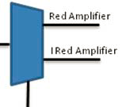
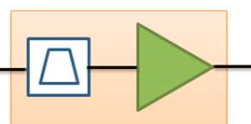

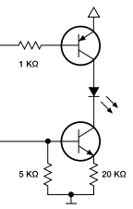
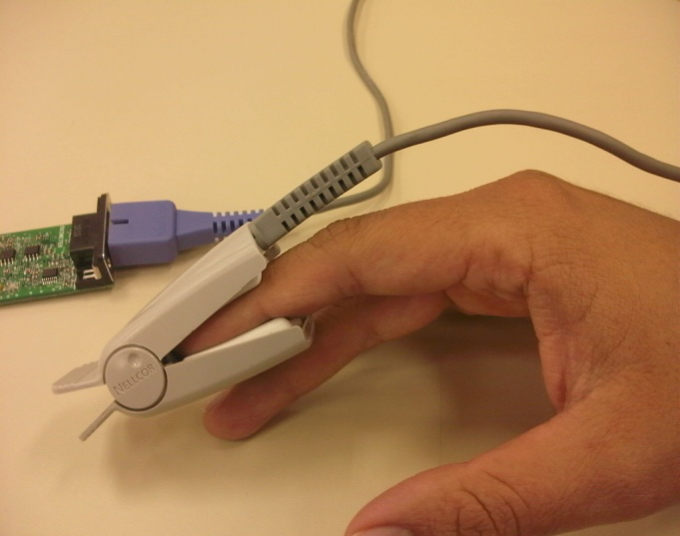
Use Case: Pulseoximeter Analog Front End
Transimpedance
Amp
Filter Amplification
Mux
Analog Techniques For Pulseoximeter
LED Driver Front End
  Transistor Driver For Increased Drive Strength
  PWM Controller - Controls LED Intensity
  GPIO LED Select
Photodiode Front End
  Transimpedance Amp - Converts I to V
  Low Pass Filter (125Hz)
  Low Input Offset Voltage (+/-3mV)
  Low Input Offset And Bias Current (+/-300pA)
  IR/Red Select (GPIO)
Filter Amplification: 4 Passive, 1 Internal
  6Hz Low Pass Filter (Remove High
  Frequency Noise)
  50/60Hz Notch Filter (Remove AC Line Noise)
  0.8Hz High Pass Filter (Remove DC
  Component Of Signal)
  6Hz First Order Internal Filter With Gain (31)
  4.8Hz Low Pass Filter
16 Bit ADC
  1mS Sample
  Software FIR Filter (0.5-150Hz)
Red
Red
Sensor
TIA
IR
IR
IR/RED Select
(GPIO)
Sample
Sel (GPIO)
Mux
ENABLE
(GPIO)
16 bit ADC
PMW
LED Driver
ENABLE
ENABLE
PWM Controller
K50 Measurement Engine IP
External Component
Notes:
Pulse Oximetry (http://cache.freescale.com/files/32bit/doc/app_note/AN4327.pdf?fsrch=1&sr=1)
Pulse Oximetry is a non-invasive procedure for measuring oxygen content in the blood and heart rate. It’s non-invasive because
there is no need to break the surface of the skin to take measurements. How is the percent of oxygen in the blood measured?
A healthy human should have an oxygen saturation rate of about 95%. Results lower than 90% may be caused by restricted
air flow, lung disease ,COPD, cigarette smoking or circulatory problems. An optical sensor fits over the index finger as shown in
the slide. The optical sensor is composed of two LEDs that transmit light through the skin (finger or translucent part of the body)
to a photodiode (detector). One LED is red with a wavelength of 660 nm and the other is infrared with a wavelength of 910 nm.
While most of this light is absorbed by tissues within the body, a small portion of the light actually passes through the finger and
is picked up by the detector. Based on the level of oxygen in the blood (hemoglobin) each LED source is absorbed differently. The
Deoxygenated blood has a higher absorption at 660nm (red LED) and oxygenated blood has higher absorption at 910 nm (Infrared).
The detector measures the light that passes through the skin for each LED. Based on the ratio of absorbed light the percent of
oxygen in the blood can be calculated . If you’re wondering how nail polish may affect readings black is the only color that can lead
to false readings. How is heart rate measured? As the heart pumps blood through the body, the amount of blood within vessels
will vary. Specifically, during the heart beat, a wave of blood causes the vessels to expand and results in a higher concentration
of blood. This increased concentration of blood will absorb more infrared light, allowing even less light to pass through to the detector.
This change in blood concentration can be translated into heart rate.
Embedded vs. External/Discrete
When you first take a look at this slide you may think wow all the analog is embedded. Yes I show the filtering as embedded but
the reality is there is only one active filter that is internal. There are actually four other passive filters that are external components.
So just keep that in mind when you look at the filter amplification circuit. As in the EKG use case embedded op-amps are used but
there is no need for an instrumentation amp. This is mainly due to the fact that the interface is completely different. Optics are used
instead of sensors attached to the body. Don’t get me wrong there are still many of the noise components found in the EKG use
case thus all the filtering. The optic interface requires an I to V conversion and that’s where the transimpedance amp is used.
The importance of this device is described in the signal chain. Again like any embedded vs. external/discrete decision it all depends
on the system and designer requirements. This is just one of example on how to implement Pulseoximeters but there are many ways
to skin a cat
Analog Signal Chain
Transmit
The Pulseoximeter starts with an optical sensor that is composed of two LEDs (optical transmitter) and a photodiode (optical receiver).
This is accomplished with the LED driver shown in the slide. The PWM controller in the K50 drives each LED but you’ll notice there are
two enables. Each enable is controlled by a general purpose I/O pin. This ensures that only one LED is on at a time. This is important
as the photo detector can only detect one light source at a time thus the need for individual control. The PWM controller has a second
function as well. It controls the light intensity of each LED. One would think that the PWM circuit could drive the LEDs directly but the
PWM lacks the drive strength to do so thus the external transistor drive circuit. Two internal timers in the K50 are used to control the
LEDs. The first is used for PWM/intensity control and the other is used to enable the LEDs. Timers are some of the Embedded advantages
I mentioned in earlier slides.
Receive
The photodiode detects when light is present and converts light into a current proportional to light intensity. The current in this case
represents the light absorption for each LED. As we move down the signal chain this current needs to be converted into a voltage so it
can be filtered and read by an ADC. A transimpedance amp is specifically designed to convert current to voltage. Transimpedance amplifiers
are commonly used in optical transceivers for high speed communications or X-ray or light measurement to convert current generated by
a photodiode into a voltage. The K50 transimpedance amp (TIA) is perfect for this because of its low input offset voltage (+/- 3mV), low
input offset (+/-300pA) and bias currents (+/-300pA) . The slide above is a little misleading as the TIA circuit does not show filtering. In
actuality the TIA circuit combines a current to voltage conversion with a low-pass filter (125Hz) to improve signal quality. The low-pass
filter is used to remove high frequency noise from the received signal. Let’s move onto the filter amplification circuit. This circuit is divided
into five filters. Four of them are passive filters and one of them is an active filter (utilizes an op-amp). Both the 660nm and 910nm signals
are processed using these filters for noise elimination and amplification. The first filter is a low pass filter with a cutoff frequency of 6 Hz
designed to eliminate high frequency noise. The second filter is a 50/60Hz notch filter. The purpose of this filter is to eliminate the 50/60 Hz
line interference. Just like EKG the interference signals include the 50-/60-Hz interference from the power supplies, fluorescent lights,
motion artifacts due to patient movement, radio frequency interference from electro-surgery equipments, defibrillation pulses, pace maker
pulses, other monitoring equipment, etc. The notch filter is referenced to Vcc/2 to add an offset voltage. The third filter is a 0.8 Hz high pass
filter. This filter removes the DC component of the signal. The fourth filter is a first order active 6 Hz low pass filter that also provides a gain
of 31. This filter uses a K50 internal op-amp. The last one is a 4.8 Hz low pass filter similar to the first one. One sample of the Red and IR
signal is taken every 1 mS. Samples are captured using the embedded 16-bit ADCs and filtered using a 0.5 Hz to 150 Hz FIR (Finite Impulse Response)
software filter. This removes the High frequency and DC component by taking advantage of the MAC (Multiply and Accumulate) DSP instruction.
Samples are stored on a software buffer and averaged.
56

Slide 57
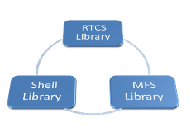
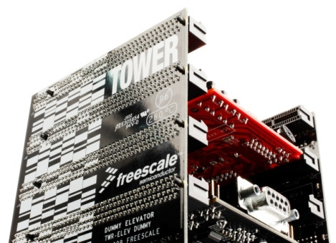
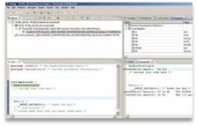


Freescale’s Microcontroller Enablement Bundle
Freescale MQX + MCU
+ Tower System
+ CodeWarrior IDE
Complimentary MQX RTOS
MQX Core
PSP & BSP
+
Modular, expandable and cost-effective development platform for 8/16/32-bit MCUs and MPUs
Rapid eval and prototyping with maximum HW reuse.
Supported by a diverse range of MCU and peripheral plug-in boards and a growing web community
Eclipse environment
Processor Expert code generation wizard
Build, debug and flash tools
Software analysis
Kernel-aware debug
Host platform support
Full-featured, scalable, proven RTOS
Simplifies HW management, streamlines SW development
Reduces development costs while speeding time to market
Comprehensive solution for embedded control and connectivity
Open source hardware platform for prototyping application development
Visual and automated framework to accelerate development time
Save time, cost, and effort.
Notes:
Freescale’s Enablement Bundle
We will now demonstrate how Freescale implements these core capabilities through the complimentary Freescale MQX™ Real-Time Operating System (RTOS)
and the low-cost, modular Tower System Development platform.
The MQX RTOS is proven, simplifies HW & SW development which, in turn, reduces development cost & time to market.
This bundle includes TCP/IP and USB software stacks and other peripheral drivers.
Tower System
Modular, VERY cost-effective, expandable – supports 8/16/32-bit processors.
Facilitates rapid prototyping and hardware reuse of building blocks from entry-level to advanced applications.
Growing web community
CodeWarrior IDE
Uses Eclipse environment
Processor expert for easy code generation
Includes build, debug & Flash tools as well as software analysis & kernal-aware debug

Slide 58


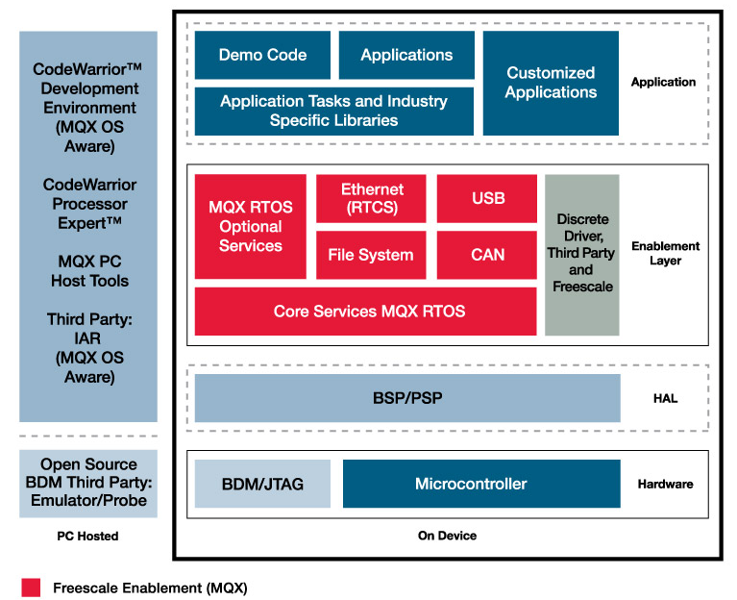
Freescale MQX RTOS Solution
Full-featured, Scalable, and Proven RTOS bundled free with 32-bit MCUs/MPUs
Software Integration headache
Full-featured and Powerful
  Tightly integrated RTCS, Middleware (USB, TCP/IP stacks), and BSPs (I/O Drivers)
  Designed for speed and size efficiency
Market Proven
  MQX has been available on Freescale processors for > 15 years
  MQX has been used in millions of products including Medical and Heavy Industrial areas
Simple and Scalable
  Intuitive API & modular architecture - fine-tune to fit application requirements
  Production source code provided
  Similar to other software OS
$95,000
of software
bundled with
Freescale
MCU’s!
Integrated MQX Solution
MQX Software speeds time to market with support from Freescale
Notes:
This slide shows a comparison between using an integrated MQX solution versus rolling your own RTOS solution.
MQX provides a tightly integrated solution, including RTOS, middleware such as USB and TCP/IP stacks, and I/O drivers on the BSP. Traditionally, you would have to put all those pieces together yourself, but with MQX it all comes ready, and complimentary, from Freescale.
MQX has been in the market for over 15 years.
MQX is owned by Embedded Access, Freescale has licensed the rights to modify and distribute free of charge when using Kinetis MCUs (as well as some ColdFire and Power Architecture processors).
BACKUP INFORMATION:
PSP: Processor Support Package
BSP: Board Support Package
Fundamentally a game changing move with our competitors:
Competitors and Past Freescale offer example code, bait and switch, up sell model: interniche stacks, CMX USB stacks or 3rd party software
The issue with CMX is that we do not own the code and cannot provide bug fixes. Also there was a huge upscale for extra features.
Customer would have to go to 3rd party RTOS companies and other 3rd party companies for middleware software.
BSP and I/O drivers are not supported on day 1.
Backed by Freescale (Advantage)
Optimize sw and hw
Maintain tested code
Allows to add Vertical Segment application code like specialized medical stacks (USB PHDC).
Enable HW features for customers migrating up ex: Nucleus (EM) Robust RTC, Flash updater
1st mover advantage => We are one of the first in the market to provide a proven and full feature software.
Freescale MQX experts are growing through global FAE, AE, TIC, and software developers
Focus on Enablement ( Another options)
Application Software
OS Platform: Linux, MQX, 3rd Party OS
Bare metal/No OS SW
Tools: CW, IAR etc..
Debugger
Provide a window to new opportunities and silicon $$.
Differentiate product offering
Increase enablement options
Simple – Reduce Time to Market
Current Results:
One of the top downloads at freescale
Competitors are reacting:
TI & SafeRTOS => Free ( But still not comparable. Only Kernel. Missing a lot of stacks and features)
Renases + micirum => Free only kernel. Still need to pay for stacks.
PSP: Processor Support Package BSP: Board Support Package
Fundamentally game changing: Sometimes providers have example code, and pieces of solutions
MQX is fully backed by Freescale - Optimized, Maintain tested code
Allows to add Vertical Segment application code like specialized medical stacks (USB PHDC).
Simple & Scalable – Reduce Time to Market
Current Results:
One of the top downloads at freescale

Slide 59
The Freescale Tower System
MCU/MPU Module:
A modular development platform for 8/16/32-bit MCUs & MPUs
  Quickly combine Tower Modules to build a prototype of your application
  Modules sold individually or in kits
  Open Source: Build your own Tower Module to integrate your IP
  Cost-optimized hardware
  Software support from Freescale and Third Parties
    MQX: RTOS with Ethernet, USB, File System, and more
    Codewarrior, IAR, Keil
  Growing community of Third Party hardware support
•
Tower controller board
Primary
•
Standalone or in Tower System
Elevator
Board
Connectors
Secondary
Peripheral Module:
Elevator
•
Up to 3 per system: Serial,
Memory, LCD,..
•
Mix & match with different
MCU modules
TWR
-
MEM
TWR
-
LCD
TWR
-
SENSOR
-
PAK
Rapidly build a prototype of your end application
Notes:
59
The tower system is a low cost evaluation and development system. The modular design allows you to plug
in different peripheral boards as well as different processor boards. With the tower system, you can start
your software development before designing your own custom board.
Open source design files, you can design your own tower module to speed development
Low cost platform for quick evaluation and development
Modular design allows for re-use of peripheral boards with different MCU/MPU boards
Open source design files, you can design your own tower module to speed development

Slide 60
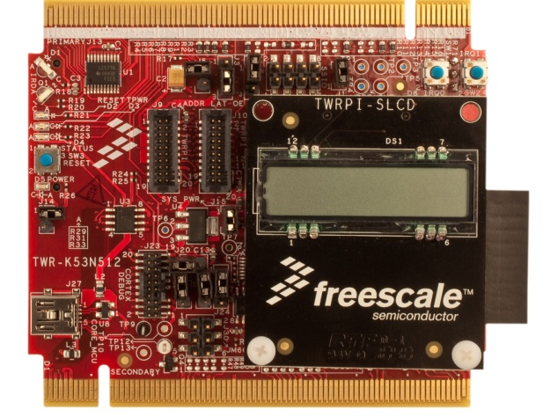
K50 Tower Kit (TWR-K53N512-KIT)
Features K53N512CMD100 MAPBGA 144
pins MCU
Tower compatible processor module
S08JM60 based open source JTAG
(JTAG) circuit
User-controlled status LEDs
Medical expansion connector
SD card slot
Connect TWRPI-SLCD board
(28 segment LCD) through TWRPI interface
Capacitive touch pad sensors and mechanical push buttons
Compatible with TWR-SER (Ethernet, USB connectivity)
MMA7660 accelerometer
Kit TWR-K53N512 TWR-ELEV
contains: TWR-SER TWRPI-SLCD
$179
$109
http://www.freescale.com/TWR-K53N512
Notes:
The TWR-K53N512-KIT is a development tool for the K53 family of Kinetis microcontrollers. This kit is part of the Freescale
Tower System, a modular, reusable development platform that allows designers to get to market faster with packaged evaluation
boards, tools and runtime software. The TWR-K53N512 microcontroller module can operate as a standalone debug tool .
The module provides an interface to the medical expansion connector and TWRPI-SLCD modules. This board can be purchased
separately or as part of a complete tower system
60

Slide 61
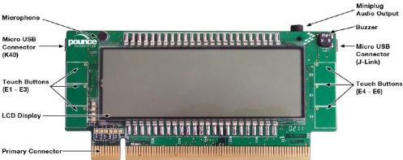
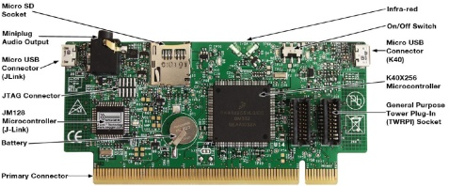
Kinetis KwikStik
K40X256VLQ100 (144LQFP) MCU
LCD display with 306 segments
J-Link USB programmer
  JTAG connector & ribbon cable not included)
2 micro USB connectors
Micro SD card slot
Infrared communications
Capacitive touch sensing interface
General purpose tower plug-in (TWRPI) socket
Manganese lithium rechargeable battery
Tower system compatible connector
Buzzer, 3.5 mm audio output jack
Omni-directional microphone
Power measurement test points (entire board or MCU)
Notes:
Kinetis KwikStik
This is the free board customers will receive for attending today's seminar. The KwikStik development tool is a
low-cost, all-in-one development tool for evaluating, developing and debugging Kinetis MCUs. It features the
K40X256VLQ100 (144LQFP) MCU with USB, Touch Sensing and Segment LCD functionality. The KwikStik development
tool can be used standalone or integrated with the Freescale Tower System. The on-board Segger™ J-Link™ debug
interface allows the user to evaluate the features of the on-board Kinetis K40 MCU or to develop, debug and
program their own target hardware based on any Kinetis MCU.
The KwikStik development tool comes pre-flashed with demonstration software to exercise a small portion
of the capabilities of the Kinetis K40X256 device and the KwikStik hardware.
Free CodeWarrior 10.1 Eclipse-based support with IDE and complimentary C compiler up to 128KB
61

Slide 62

Freescale Product Longevity Program
Freescale offers a formal product longevity program for the market segments they serve
  Automotive product availability
  15 year minimum
  Medical product availability
  15 year minimum
  All other market segments
  10 year minimum
  Life cycles begin at the time of launch
Freescale has a longstanding track record of providing long-term production support
A list of participating Freescale products is available at: www.freescale.com/productlongevity

Slide 63
Embedded Data Converter Evaluation Demo
Embedded data converter evaluation demo using Kinetis K60 tower board
  Show the ambient noise on the ADC
  Show the total system noise
  Use shell commands and web page to set the DAC output voltage
  Show the ADC reading using the webpage and MQX shell.
  Use a digital multimeter to verify the readings are accurate
Video 1
Video 2
Notes:
http://faewiki.arrow.com/@api/deki/files/13229/=Kinetis_internal_analog_evaluation.mov
63

Slide 64
External Data Converter Evaluation Techniques
With LTC Analog Playground Board

Slide 65
Linear Technology Analog Playground Solutions
TWR-ADCDAC-LTC
Notes:
The LTC Analog Playground Board contains four mixed signal devices from Linear Technology
Also contains a boost converter to generate the board suplies and a voltage reference for the ADC and DACs
65

Slide 66
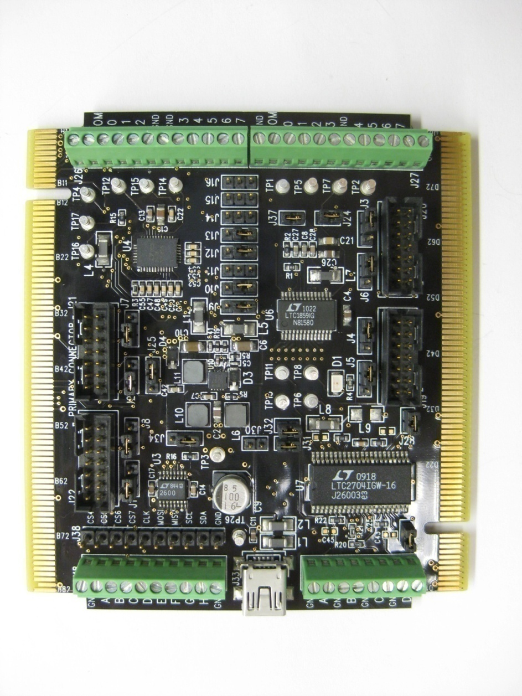
Expansion Possibilities
QuikEval Expansion Headers provide interface to over 130 high performance products, including:
LTC6802 High Voltage battery stack monitor
LTC4266 Quad Power over Ethernet (PoE) PSE controller
LTC4151 High Voltage & Current monitor for telecom applications
Numerous precision ADCs and DACs, and much more!
Notes:
Emphasize that any quickeval board can be connected to the four quickeval connectors on the board.
www.linear.com/quikevaldemo (CHECK THIS LINK!)

Slide 67
Vast Selection of Linear Technology Boards that can Plug into the LTC Peripheral Plug-in Module
DACs:
DC1397A-A (LTC2656)
DC1074A (LTC2630)
DC1466A-A (LTC2636)
DC1593A-A (LTC2635)
DC1684A-A (LTC2758)
DC1678A-A (LTC2654)
DC1112A (LTC2751)
DC777A (LTC2601)
DC1096A (LTC2642)
Delta Sigma ADCs:
DC1266A-A (LTC2453)
DC570A (LTC2440)
DC1628A (LTC2470)
DC1492A (LTC2462)
DC939A (LTC2484)
DC956A (LTC2485)
DC1009A-A (LTC2492)
DC1012A-A (LTC2499)
DC979A (LTC2442)
DC1742 (LTC2449)
SAR ADCs:
DC1783A-E (LTC2379)
DC1571A-A (LTC2383)
DC1186A (LTC2308)
DC1137A (LTC2309)
DC1190A-A (LTC2365)
* Over 100 different boards
Notes:
Vast Selection of Linear Technology Boards that can Plug-N-Play into the LTC Peripheral Plug-in Module. You can order those board through Arrow & LTC.
67

Slide 68
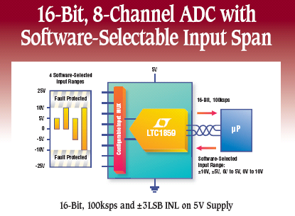
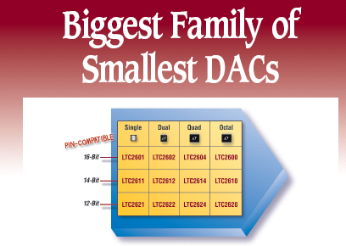
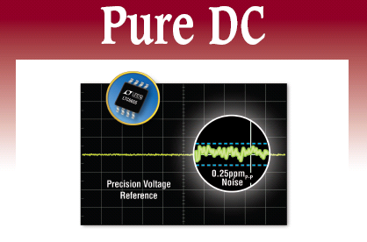
Linear Technology Analog Playground Content
Delta Sigma ADC
  LTC2498
Successive Approximation Register (SAR) ADC
  LTC1859
Serial SPI DAC
  LTC2600
Precision SoftSpan DAC
  LTC2704
Precision voltage reference
  LTC6655
Notes:
This slide talks about the Ics from LTC on the playground board. The LTC2498 is part of a family of 1-16 channel, 16-bit and 24-bit delta-sigma ADCs. Perfect for portable medical applications.
68

Slide 69
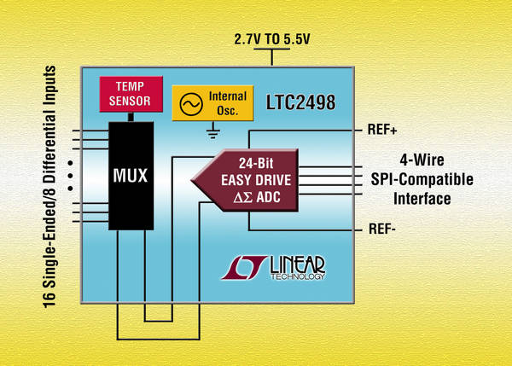

LTC2498: 24-Bit, 16-Channel Easy Drive DS ADC
8 differential/16 single-ended input channels
Easy drive technology enables rail-to-rail inputs with zero differential current
Directly digitizes high impedance sensors with full accuracy
600nV RMS noise
Internal temperature sensor (2oC max), internal oscillator
Selectable 50Hz, 60Hz rejection, up to15Hz output rate
Applications:
Direct sensor digitizer
Direct temperature measurement
Instrumentation
Industrial process control
Notes:
The LTC2498 is part of a family of 1-16 channel, 16-bit and 24-bit delta-sigma ADCs. Perfect for portable medical applications.
The LTC2498 features the Easy Drive technology from Linear Technology which enables rail to rail inputs with zero differential input current.
Also includes an internal temperature sensor. A thermocouple can also be attached for external measurements.
Where used: Spectometer, Chromotography, Oxygen Sensor , RTD Instrument, Moisture Analyzer, Datalogger , Industrial oven, Medical bed, Temp Controller, Building automation, Hydrid fuel cell, Solar Charger, Injector System, Strain Gauge, Heat Tracer Controller , CRYOCOOLER, Liquifier , Gas Meter, Flight Sim , 4-20mA LOOP, Ultra Low Temperature Freezer, Pressure sensor
69

Slide 70
LTC ΔΣ ADC Overview
12.5%
V_{REF}
V_{REF}
V_{REF}
V_{REF}
V_{REF}
V_{REF}
+V_{REF}/2
I_{IN}+
I_{IN}+
6.8sps
5V
60sps
16 bit
10 Speed
Gear Switch
I_{DIFF}=0
4ksps
I_{IN}-
0V
-V_{REF}/2
I_{IN}-
0V
-12.5%
Notes:
70
This slide gives you an overview LTC Delta Sigma ADCs family offering. The LTC2498 belongs to the Easy drive delta sigma ADC family.

Slide 71
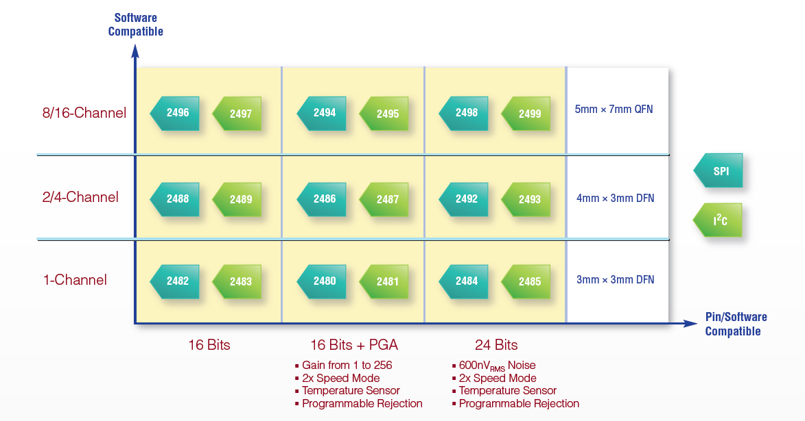
Complete Easy Drive ΔΣ ADC Family
Notes:
71
This slide gives an overview of the entire Easy Drive 1-channel to 16-channel Delta Sigma ADCs. The LTC2498 is a 8-/16-channel Differential or Single-Ended 24-bit Delta Sigma ADC.

Slide 72
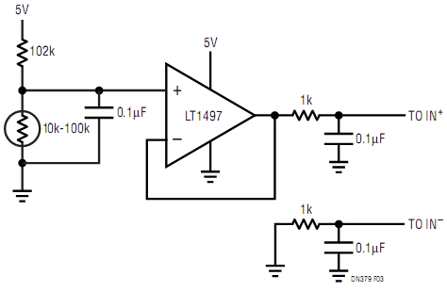
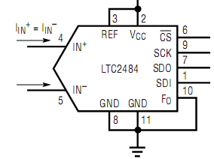
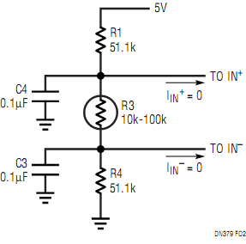
Making Easy DriveTM Work For You
μ power LT1494
Not true Hi-Z, but makes life much easier
Refer to DN379
Notes:
Additional circuitry for conditioning not needed for easy drive delta sigmas anymore.
The LTC2498 combines a high precision delta-sigma ADC with an automatic, differential, input current cancellation front end. A proprietary front end passive sampling network transparently removes the differential input current. This enables external RC networks and high impedance sensors to directly interface to the LTC2498 without external amplifiers. The remaining common mode input current is eliminated by either balancing the differential input impedances or setting the common mode input equal to the common mode reference (see the Automatic Differential Input Current Cancellation section). This unique architecture does not require on-chip buffers thereby enabling signals to swing beyond ground or up to VCC. Moreover, the cancellation does not interfere with the transparent offset and full-scale auto-calibration and the absolute accuracy (full-scale + offset + linearity + drift) is maintained even with external RC networks.

Slide 73
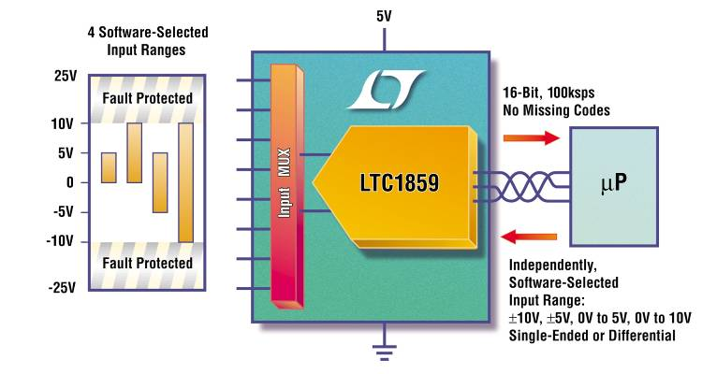
LTC1859: 16-Bit SoftSpanTM ±10V Input ADC
8-channel, 100ksps 16-Bit ADC
SoftSpan input ranges
(0-5V, 0-10V, ±5V, ±10V)
Fault protected to ±30V
Single 5V supply
40mW power + sleep
Applications:
Industrial process control
High speed data acquisition for PCs
Digital signal processing
Notes:
The LTC1859 allows the user to select from four different input ranges using software. This gets rid of the need for expensive amp/resistor networks or manually switching jumpers to change input ranges.
Best DC spec is INL (3LSB max)
millivolts of offset (2mV in 5V range)
0.1% gain accuracy
Good AC performance to 10kHz (“full linear bandwidth”)
1MHz “full power bandwidth” – must consider noise to this frequency and beyond.

Slide 74
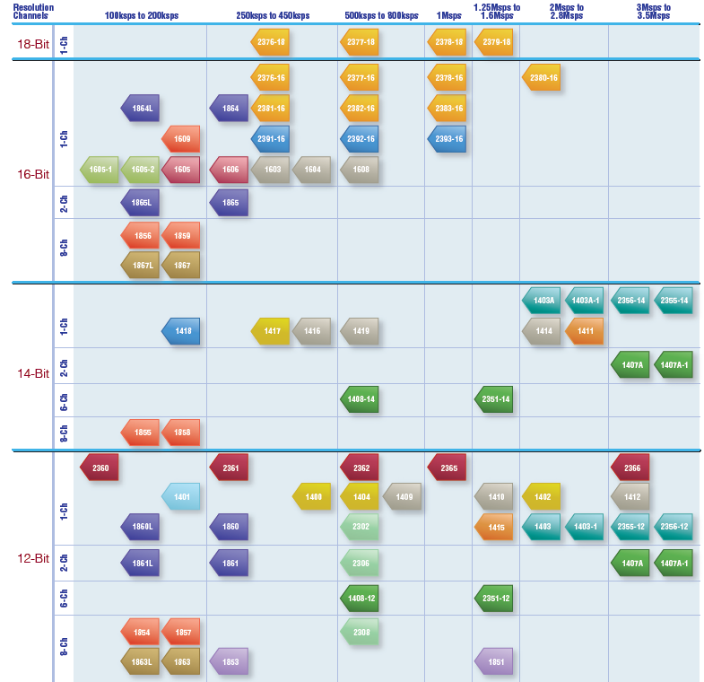
LTC General Purpose SAR ADCs
Notes:
74
This slides gives you an overview the 12-bit to 18-bit SAR ADC portfolio that LTC has to offer to customers.

Slide 75
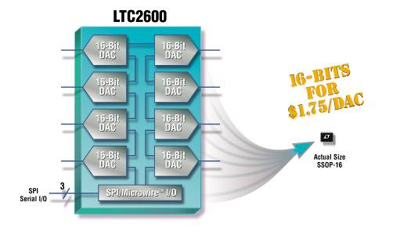
LTC2600: Complete 16-/14-/12-Bit Single, Dual, Quad, Octal DAC Family for Closed Loop Systems
Pin Compatible Octal DAC Family
  16-Bit (LTC2600), 14-Bit (LTC2610), 12-Bit (LTC2620)
  Tiny DACs: 16-pin SSOP, MSOP-10, DFN Packages
Low Power Operation
  250µA Per DAC at 3V
  325µA Per DAC at 5V
Individual DAC Power-Down
Rail-to-Rail Buffered V_{OUT}
Independent or Simultaneous DAC Updates
Applications:
Mobile communications
Process control and industrial automation
Instrumentation
Automatic test equipment
Notes:
The LTC2600 is a family of DACs ideal for closed loop systems. Pin-compatible choices include 16, 14, or 12 bits of resolution, SPI and I2C interfaces, and one, two, four, or eight DACs in a small package. All of these DACs are 16-bit, 14-bit, and 12-bit monotonic as pointed out by the red arrow. A differential nonlinearity of +/-1LSB maximum guarantees the DAC’s monotonicity, meaning the analog output always increases or stays the same with an increase in the digital code, but never decreases. The 16-bit DACs in the LTC2600 family offer +/-64LSB INL. We’ll discuss the differences in INL in more detail a bit later.
Ultralow Crosstalk Between DACs: 10µV
2.5V to 5.5V Supply Range
2600 :INL ±64LSB, DNL ±1LSB
2610: INL ±16LSB, DNL ±1LSB
2620 INL ±4LSB, DNL ±0.5LSB

Slide 76
LTC Single/Dual/Quads/Octal V_{OUT} DACs
Notes:
76
This Slide give you an overview of the multichannel 8-bit to 16-bit DACs offered by LTC. The LTC2600 is an Octal 16-bit VOUT DAC.

Slide 77
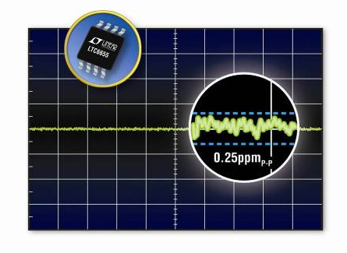
LTC6655: 0.25ppm_{P-P} Noise Precision Voltage Reference
Features:
Low Power
  7mA max supply current
  Shutdown mode (12µA)
  500mV max dropout voltage
  ±5mA output drive
Rugged
  -40°C to 125°C fully specified, 100% tested
  Up to 13.2V supply
  MSOP-8 package
Parameter | LTC6655
Initial Accuracy | 0.025% Max
Temperature Drift | 2ppm/°C Max
Noise | 0.25ppm_{p-p}
Hysteresis | 60ppm
Long-term Drift | 60ppm/√kHr
Line Regulation | 5ppm/V
Load Regulation | 10ppm/mA
Applications:
Instrumentation and Test Equipment
High Resolution ADCs
Weigh Scales
High Temperature Applications
Medical Equipment
Precision LDO Regulator
Notes:
77

Slide 78
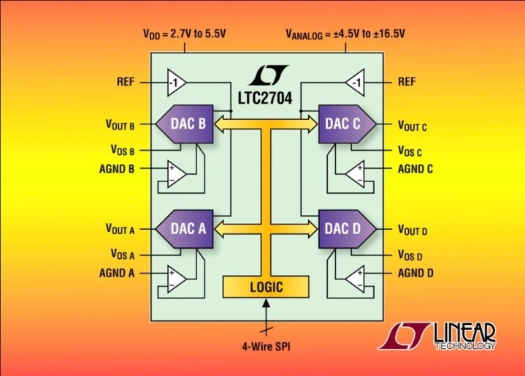
LTC2704 Quad 16-Bit Precision SoftSpan DAC
High accuracy: maximum 1LSB DNL error & 2LSB INL error over temperature
Force/sense outputs for remote sensing
Six software selectable output ranges: 10V, ±10V, 5V, ±5V, ±2.5V, -2.5V to 7.5V
Pin-compatible 16-/14-/12-bit family
Serial readback of all on-chip registers
Force/Sense outputs enable remote sensing
Glitch impulse: < 2nV-sec
Outputs drive ±5mA
Applications:
Process control
Industrial automation
Direct digital waveform generation
Software controlled gain adjustment
Automated test equipment
Analog Playground Demo
Notes:
78
Features
Six Programmable Output Ranges:
Unipolar: 0V to 5V, 0V to 10V
Bipolar: ±5V, ±10V, ±2.5V, –2.5V to 7.5V
Serial Readback of All On-Chip Registers
1LSB INL and DNL Over the Industrial Temperature Range (LTC2704-14/LTC2704-12)
Force/Sense Outputs Enable Remote Sensing
Glitch Impulse: < 2nV-sec
Outputs Drive ±5mA
Pin Compatible 12-, 14- and 16-Bit Parts
Power-On and Clear to Zero Volts
44-Lead SSOP Package
High resolution, precision DACs are used extensively in industrial, medical and instrumentation applications. The are often used in open loop control systems to set levels, adjust comparator trip levels, provide analog output signals (chart recorders, data acquisition boards, etc.) and to provide feedback information during system debugging.
Apps: Digital Exciter, Data Acquisition , Pressure Transducer, Heating Pump Control , Robot for marine investigation , PLC, ATE, VXI Test Bench, VME bus I/O board, Motion control board, Iris Scanner , Actuator, DSL Router, Thermocouple Node, vacuum cleaner control , Air analyser, precision drilling machine-tool , PC based oscilloscope

Slide 79
External Data Converter Evaluation Techniques
With LTC Analog Playground Board

Slide 80
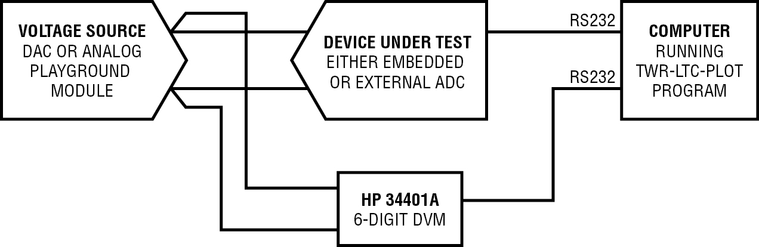
How to Evaluate ADCs
Generate a voltage and use the Device Under test (DUT) to measure
The same measurement will also be performed by a 6-digit Digital Voltmeter (DVM)
A simple PC program can compare the measurements from the DUT and the DVM
Any errors in the ADC will be revealed from this comparison
Compare
Test Setup
Notes:
80
The idea here is to generate a voltage (Fluke Source) and use the DUT to measure it. The same measurement will also be performed by a 6-digit Digital Voltmeter (DVM). Both the DUT and the DVM will be interfacing with the PC. A simple PC program can data log and compare the measurements from the DUT and the DVM allowing us to look at the accuracy of the ADC vs. the DVM. The assumption here is that the DVM is much more accurate than the DUT and any errors in the ADC will be revealed from this comparison.

Slide 81
ADC Evaluation Technique Using the Tower Platform & Analog Playground
Create a “loop back connection” between the DAC on the Analog Playground Board and the ADC (either on board or off board)
Other ADCs from Linear Technology can be connected via the QUICKEVAL connectors
Generate a “Sweep” with the DAC and sense with both the ADC and the external DVM
Compare the result from the ADC and the DVM to evaluate the performance of the ADC
Test Setup
Notes:
81
The setup with the Tower Platform:
Create a “loop back connection” between the DAC on the Analog Playground Board and the ADC (either on board or off board). The next few slides talk about how to achieve this for the ADCs on the tower board. Other ADCs from Linear Technology can be connected via the QUICKEVAL connectors.
Generate a “Sweep” with the DAC and sense with both the ADC and the external DVM. We will compare the result from the ADC and the DVM to evaluate the performance of the ADC
There are two test cases here:
Testing the external ADC: There are two ADCs on the Analog Playground board: LTC2498 or LTC1859. Additionally, other ADCs connected to the QUICKEVAL connector can also be tested.
Testing the embedded ADC: Make the same connections from the DAC to the embedded ADC. Then use the DVM to measure the sweep voltage. Then compare the results of the “ideal” measurement form the DVM and the measurements from the embedded ADC

Slide 82
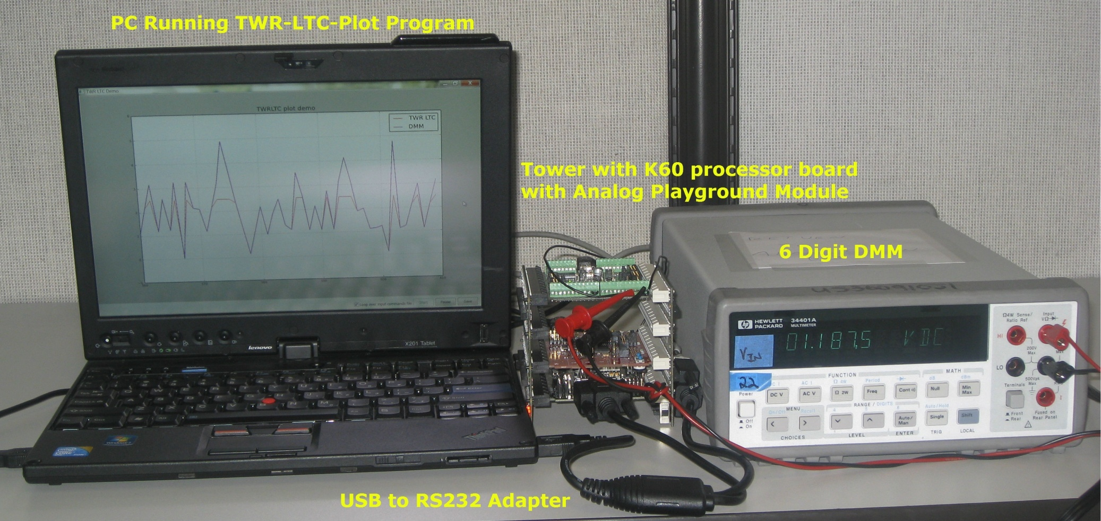
ADC Evaluation Technique Using the Tower Platform & Analog Playground
Test Setup
Notes:
82
The setup with the Tower Platform:
Create a “loop back connection” between the DAC on the Analog Playground Board and the ADC (either on board or off board). The next few slides talk about how to achieve this for the ADCs on the tower board. Other ADCs from Linear Technology can be connected via the QUICKEVAL connectors.
Generate a “Sweep” with the DAC and sense with both the ADC and the external DVM. We will compare the result from the ADC and the DVM to evaluate the performance of the ADC
There are two test cases here:
Testing the external ADC: There are two ADCs on the Analog Playground board: LTC2498 or LTC1859. Additionally, other ADCs connected to the QUICKEVAL connector can also be tested.
Testing the embedded ADC: Make the same connections from the DAC to the embedded ADC. Then use the DVM to measure the sweep voltage. Then compare the results of the “ideal” measurement form the DVM and the measurements from the embedded ADC

Slide 83
PC Program That Compares the Measurements from the DUT and the DVM
Notes:
The LTW-TWR-PLOT program plots the measurements from the ADC and the DVM on a plot.
The red plot is the measurement from the ADC on the Analog Playground Board and the purple plot is the measurement form the DVM. The DAC generates a ramp signal that is used to plot the transfer function of the ADC. The transfer function is also measured by the DVM.
The plot currently shows the voltages form the DAC generated randomly; however, the command set to plot the transfer function will provide a ramp voltage source that will be used to create the transfer function.
These two measurements will be saved in a comma separated value (csv) file that can be opened with Excel or other spreadsheet program. Then the DNL, INL and other error terms can be calculated from this transfer function. A cursory observation can also reveal the error from the ADC measurement by comparing it to accurate measurements from the 6-digit DVM.

Slide 84
External Data Converter Evaluation Demo Using Analog Playground Board
Digital multi-meter plot demo to evaluate ADC accuracy
Notes:
http://faewiki.arrow.com/@api/deki/files/13232/=ltc_demo.zip
84

Slide 85
External Data Converter Demos Using Analog Playground Board
Analog playground board demos on tower
  Thermocouple reader
  DAC and ADC loopback
  ADC data logger
  Demo
Notes:
85

Slide 86
Summary
Understand system requirements
  Accuracy, performance, noise levels, cost, power
  Consider trade-offs between embedded and external data converters
Use available tools and techniques to evaluate embedded and external data converter performance
  Freescale tower system, LTC analog playground board, expansion board, external ADC evaluation demo and software

Slide 87
For Further Evaluation
50% off boards for seminar attendees only (expires: 12/31/2011)
  TWR-ADCDAC-LTC (part #: TWR-ADCDAC-LTC**PROMO)
  TWR-K60N512-KIT (part #: TWR-K60N512-KIT**PROMO)
  TWR-K53N512-KIT (part #: TWR-K53N512-KIT**PROMO)
Gift for every attendee: Kinetis KWIKSTIK

Slide 88
Contact Information
Rob Mauro
Arrow FAE
rmauro@arrow.com
Carl Joubert
Freescale Technical Sales Engineer
Carl.joubert@freescale.com

